Slide 3
Our vision as a Church of England school places Christian values at the heart of everything we do. The values are encapsulated in the acronym STRIVE - ‘Safety, Togetherness, Respect, Integrity, Valued and Excellence’. As a school community, we aim to serve one another and work together for the common good, so that everyone can experience life in all its fullness. (John 10:10). The parable of the mustard seed (Mark 4:30-32) can represent our children, who are nurtured here, and enabled to live life in its fullness through our teaching and care. It can also represent our school flourishing within our community and the community connecting to our diverse world.

Slide 4
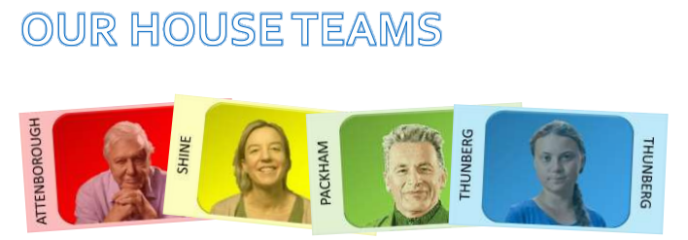
At Sutton Primary School, we have four house teams. These are based upon inspirational figures linked to nurturing and caring for our environment. When children join, they are allocated to a house team. For each house, we have a male and female house captain from Year 6. House Captains are responsible for promoting the ethos and values of their house, encouraging pupils to do their best in house competitions, and helping staff organise competitions. In line with our Behaviour Policy, throughout each day pupils can earn House Points for excellent effort in learning, excellent effort when completing home learning tasks, being an outstanding role model as well as many other opportunities. House Points accumulated each week are counted and in our weekly Celebration Assemblies the winning house for the week is announced. At the end of the academic year, the winning house is awarded the Rev. Mary Hancock House Cup.

Slide 5
Rewarding the Positive
We will be rewarding the children with praise focusing on positive behaviours.

Slide 6
Behaviour Policy
In order to reinforce behaviour expectations, Sutton Primary School use the following staged approach from our draft policy
Redirection – gentle encouragement to do the right thing.
Reminder – after giving the child time to process the redirection they will be reminded of what is expected.
Caution – calmly tell the child privately your expectations
Time in – in peaceful place in classroom or the reflection garden
Educational consequence – time spent during playtime to discuss the desired behaviour in class.
Internal referral – time in – 10 minutes in a partner class with work provided by the class teacher.
Reparation – for an educational consequence or internal referral. Chance to set positive goals for the future.
Notes:
Behaviour expectations
Uniform (shoes not trainers)
Exemplar work

Slide 7
Adults in my child’s class
Salamanders
Teacher - Mrs Dockerill
TA - Ms Sprowell
Tigers
Teachers - Mrs Jeeves (Monday and Thursday)
Miss Watts (Tuesday, Wednesday and Friday)
TA - Mrs Kent
Wolves
Teacher - Miss Holland
TA - Mrs Fleming
Although TAs are based in these rooms, they do have a number of responsibilities across the school. This means they are not solely working alongside one class.
Notes:
Behaviour expectations
Uniform (shoes not trainers)
Exemplar work

Slide 8
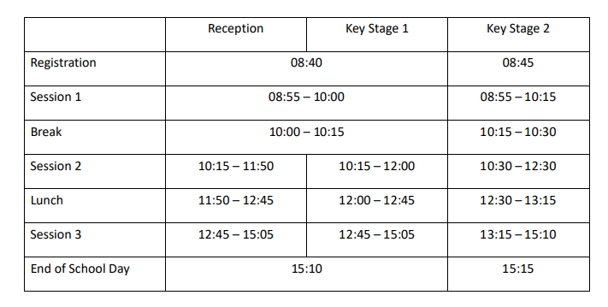
Our School Day
Pupils arriving after 8.55am are late and will be marked accordingly in the register. Please ensure your child comes to school on time. Pupils who are late should report to the school office. If you bring your child to school by car, we would ask you to note and respect the parking restrictions around the school site.

Slide 9
Fruit Snacks
Please encourage your child to bring piece of fruit for their morning snack if in KS2 (from Monday 12th September it will be fruit only - not fruit winders or cereal bars). In KS1 fruit is provided by the government. Fruit is a great energy booster, and packed with vitamins to boost immunity, so makes a great mid morning snack!

Slide 10
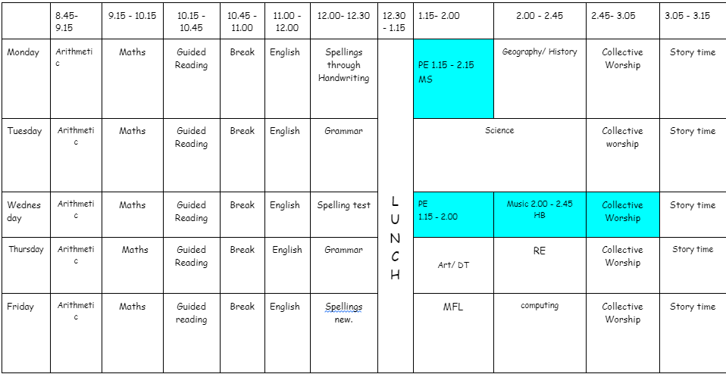
Our Class Timetable
Each class has a slightly different timetable - Science/ PE/ART/DT/PSHE/ /RE/Computing/Music will usually take place in the afternoons
Notes:
Handouts?
PE days

Slide 11
Our Class Timetable
PE DAYS
Salamanders
Wednesday and Friday
Tigers
Monday and Wednesday
Wolves
Tuesday and Wednesday
As children come to school in their PE kits, lessons may be swapped around if required (mainly weather related).
Notes:
Handouts?
PE days

Slide 12
What are we learning?
Our Curriculum
Across the school, we follow the National curriculum and a cross curricular approach to learning. There is a clear focus on maths and English, but we strive to ensure that there is a broad, balanced and engaging curriculum across the school. Wherever possible clear links are made between subjects and each term classes have a different topic focus. Children develop their knowledge, skills and understanding and we provide a clear progression for these across the school.
At Sutton we have a carefully designed curriculum that promotes the curiosity of our pupils. We plan progressive learning with clear yearly objectives which build in small steps, recapping before moving on. We provide differentiated challenges - You may hear your child mentions - paddling, snorkelling and diving - As this relates to the level of challenge they have had a go at.
More information can be found on our school website: https://www.sutton.cambs.sch.uk/web/curriculum_2/582663
Sutton School has now adopted a mastery approach to mathematics. The mastery approach is a set of principles and beliefs on how children can best learn. We believe that all children are capable of understanding and doing the maths taught in their year group and that no child is ‘just bad at maths’. With good teaching, appropriate resources, effort and a positive ‘can do‘ attitude all children can achieve in and enjoy mathematics.
In practice, children will spend longer mastering each concept through small steps. Rather than pushing children onto larger numbers, or ‘harder maths’, those who grasp concepts quickly are encouraged to explore them in a variety of contexts and solve increasingly complex problems using them. This leads to a more thorough understanding of concepts taught and gives a firm foundation for the next year’s learning.

Slide 13
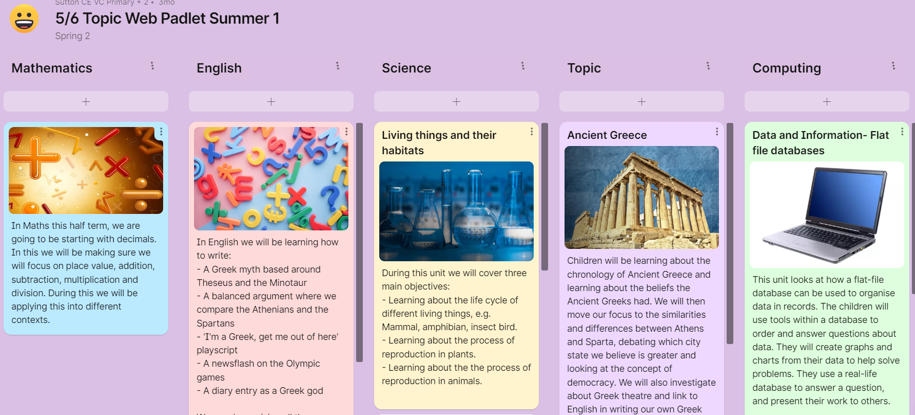
Padlets
These are shared with you termly, to give you an overview of what your child will be learning in each subject.

Slide 14
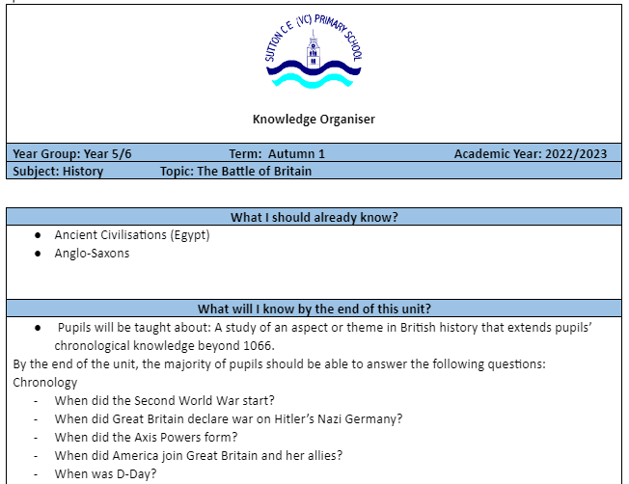
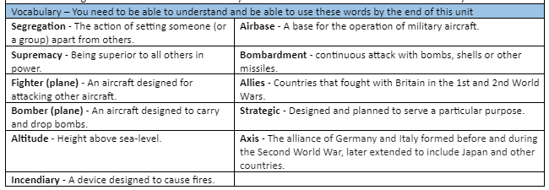
Knowledge Organisers
Each term, these along with the topic webs are on the website - so you can support your child with revisiting key concepts and vocabulary at home.

Slide 15
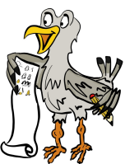
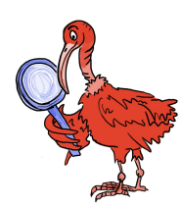
Vipers
When working on reading, we use VIPERS. During the course of Guided Reading and other reading with an adult, your child will have the opportunity to answer questions from a range of these areas.

Slide 16
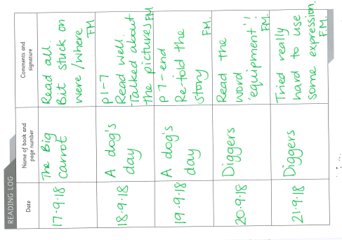
Reading Records
Children are to record each time they read
They can record their Guided Reading book in there
Please read 4 times a week

Slide 17
Spelling
Each week your child will be given spellings to learn focused around a spelling pattern which will be tested during the week.
Spellings will be sent home on a Friday and tested the following Wednesday.

Slide 18
New spellings go out: Friday
Spelling test on: Wednesday
Log On:Stuck into reading record book.
We can print out spelling lists and activities if your child does not have access to a device.Please let us know if this is something you require.

Slide 19
End of Year Expectations

Slide 20
Assessment
Throughout the year there will be formative and summative assessment of the children across the curriculum. These judgements will be moderated internally, by Subject Leaders and within the cluster.
The evidence gathered will show that your child is working within one of the following:
Pre Key stage
Working towards age related expectations (WTS)
Working at age related expectations (ARE)
Working at greater depth (GDS)

Slide 21
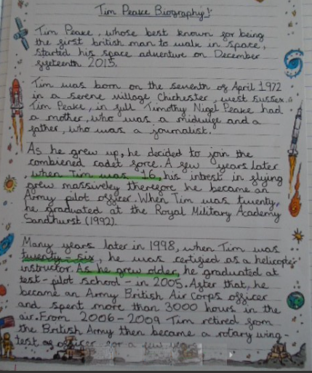
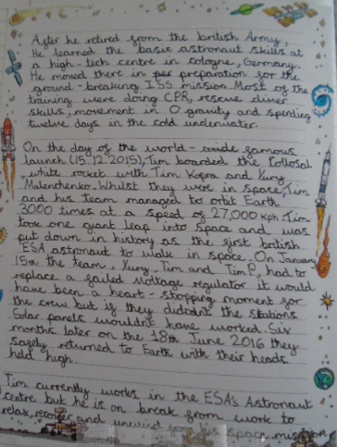
This is an example of a child working at the expected standard for writing at the end of Year 5.
Notes:
We will upload the statements to the website for you to see/ a link to the government website

Slide 22
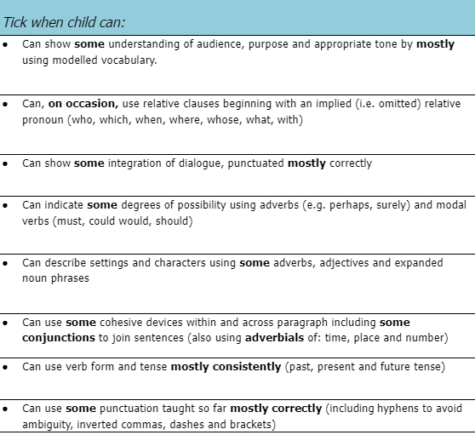
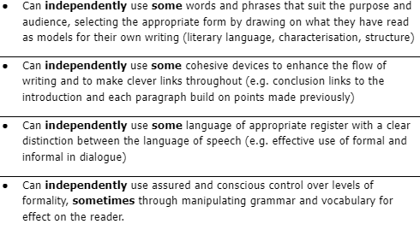
These are the writing targets we work on throughout year 5.
Notes:
We will upload the statements to the website for you to see/ a link to the government website

Slide 23
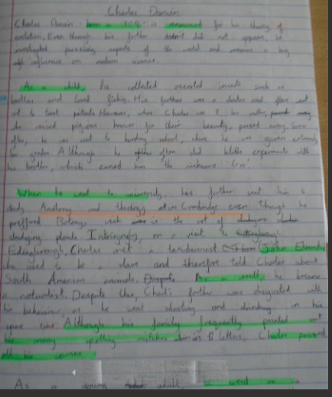
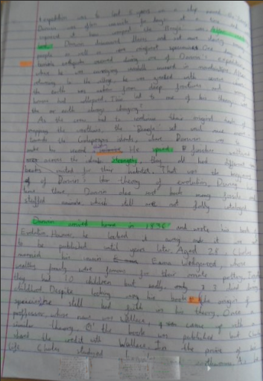
This is an example of a child working at the expected standard for writing at the end of Year 6.
Notes:
We will upload the statements to the website for you to see/ a link to the government website

Slide 24
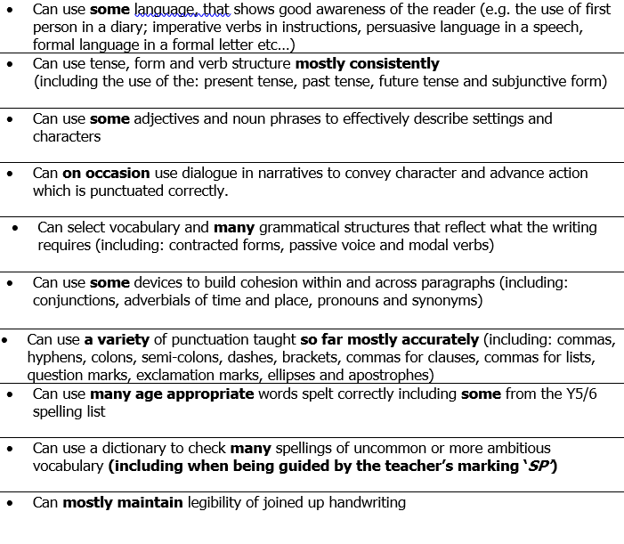
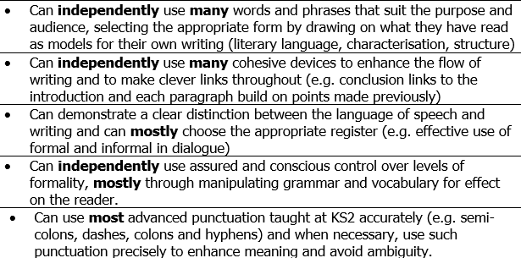
These are the writing checklists for children working in Year 6:
Notes:
We will upload the statements to the website for you to see/ a link to the government website

Slide 25
Year 6 SATS
SATS will happen in May but we’ll give more information on these as needed nearer the time.
We want to keep the process stress-free for the children.
There will be a reading paper, 2 SPAG papers and 3 maths papers.
Children will be prepared throughout the year by taking part in everyday learning.

Slide 26
Year 6 SATS
SATS will be overseen by the class teacher and an additional adult.
The papers last between 20 and 60 minutes

Slide 27
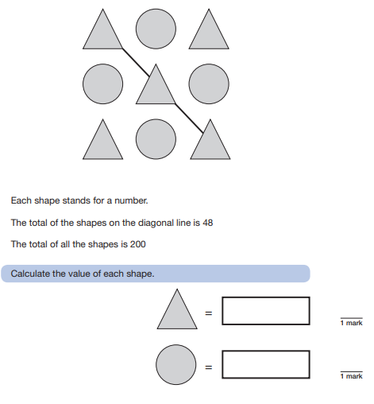
Year
6 SATS
We work on SATS style
questions throughout the
year so children will be
used to answering
questions like this as part
of their ordinary routine.

Slide 28
Communication
School newsletters
Dojo
Pupil Asset
Website
Arrange a teacher meeting through the office (virtual or at a distance)
Notes:
Upcoming dates for trips
Assessments (SATS/Y4 timetable check)
How you can support children at home

Slide 29
Communication
Do let us know if you need any financial support, as it is possible you can be supported through pupil premium.
Were you aware that last year 20% of the children in Cambridgeshire who were eligible for a Free School Meal did not do so? Currently a school will receive £1,300 per pupil claiming Free School Meals. This money is called Pupil Premium Funding and can be used to support the child’s education in the form of smaller classes, TA support, if necessary or funding to help the pupil’s parents to meet the cost of school trips. This additional income is only received by the school if you apply for Free School Meals, however, please note that your child does not have to have a Free School Meal if they would prefer not to.
Don’t delay - Apply today! The office will be happy to support you - so do contact them, or let your class teacher know. There are also details on our website: https://www.sutton.cambs.sch.uk/web/pupil_premium_information/51473
Notes:
Upcoming dates for trips
Assessments (SATS/Y4 timetable check)
How you can support children at home

Slide 30
Birthdays
As a healthy school we observe the school policy of birthday book donations.
When it is your child's birthday, if you would like to, you can donate a book that your child's loves to the school. The book will be will be labelled with a special birthday sticker and placed in our lovely library for other children to then enjoy too.
Any students who bring in sweets for birthdays, will kindly be asked to take the sweets back home as we need to be mindful of healthy eating and dietary restrictions for various students.

Slide 31
The Year Ahead
Supporting your child at home
Notes:
Upcoming dates for trips
Assessments (SATS/Y4 timetable check)
How you can support children at home

Slide 32
Homework Expectations
Reading expectations in Guided reading. All children will be set a specific amount to read in Guided Reading. They are all aware that it is their responsibility to make sure this is done each week. If they don’t manage it in the sessions then they can take the book home.
Spellings. As explained before these are set on a Friday and then tested the following Wednesday.
Times tables. It is expected that by the end of Year 4 that children should know their times tables to 12 x 12. If your child does not then please make sure they are using TTRS as much as possible to help them secure them.
CPG books. As of January Year 6 will be set tasks from CPG books to help with the revision for SATs.

Slide 33
What can you do?
Read to your child, read with your child and have your child read to you.
Spellings – weekly spelling set on Spelling Shed.
Times tables - children have access to Times Table Rockstars.
Use the knowledge notes to recap key vocabulary and to help you discuss topics with your child.
Communicate with us! Let us know how it is going, and do let us know if you need any support :-)

Slide 34
Hilltop
We have chosen Hilltop as our children will be given the opportunity to take part in a variety of carefully supervised adventurous activities which will build their confidence and teamwork skills.
Hilltop’s moto is ‘challenge by choice’ and just like in school, the children will set their own level of challenge for each activity.
The centre is set in safe, enclosed grounds and children work in groups of no more than 10 (per appropriately qualified adult) during the activity sessions.
This year our Hilltop residential will be from
28th February - 1st March 2024

Slide 35
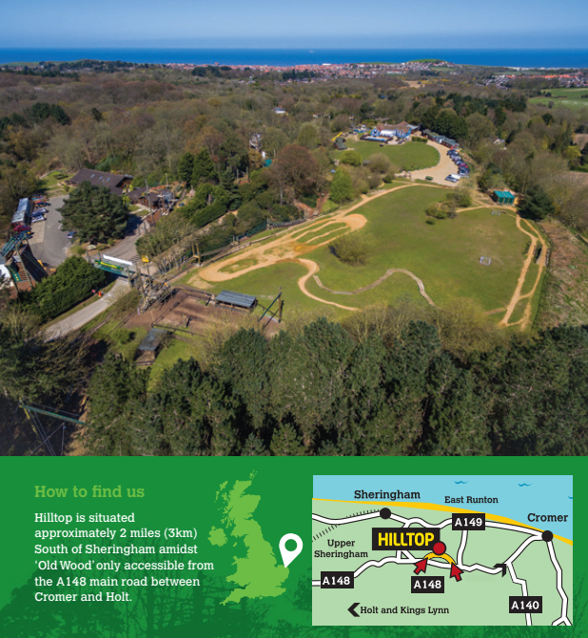

Slide 36
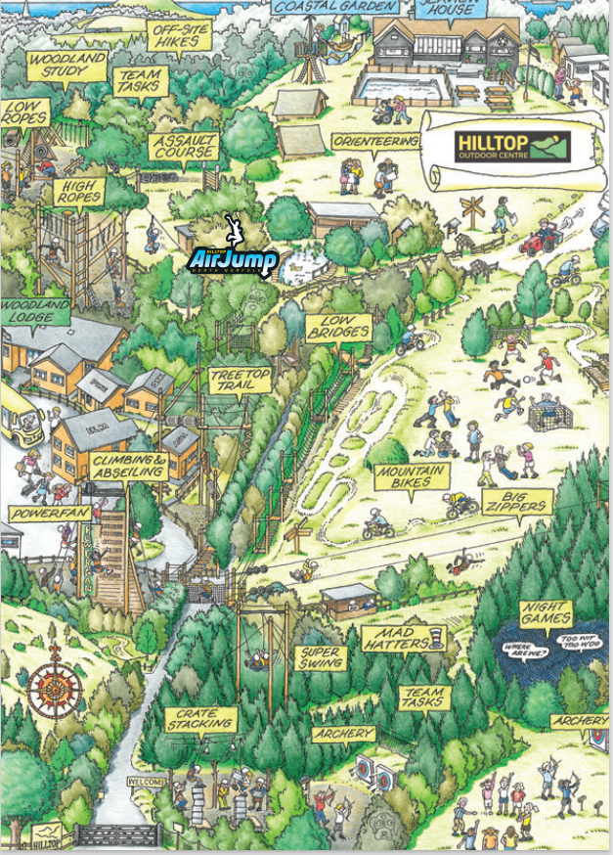

Slide 37
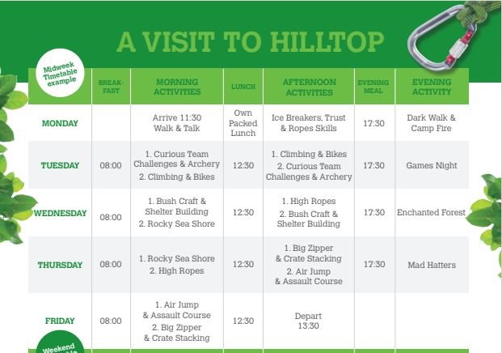

Slide 38
Prep School Trip to Hilltop - YouTube

Slide 39
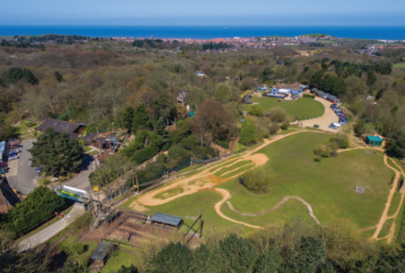
Hilltop Costs
Unfortunately, we cannot give a final cost at this stage, as it does depend on the uptake of places, so the final payment will be adjusted accordingly.
The anticipated cost will be no more than £250.00.
Children in receipt of pupil premium funding are entitled to a 50% discount, however if you feel you may need financial assistance, please do come and talk to Mrs Newling or Mrs McCullough about possible support in meeting part of these costs.
You are able to pay by 5 monthly instalments.

Slide 40
Thank you!
We welcome any questions.

