Slide 1
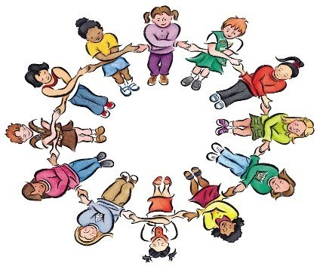
Friendship Ambassadors

Slide 2
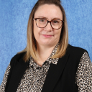
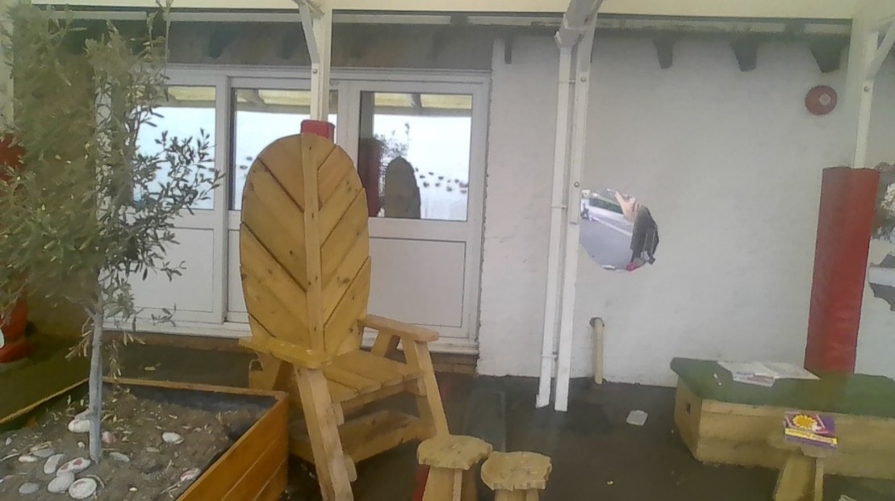
Here is the Quiet Zone… You can come here if you just want some space and to have some time out of the busy playground…
Mrs Braybrooke will still be here. Children should come to the quiet zone if they want to chat or do quiet activities like colour or read.

Slide 3
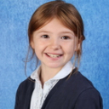
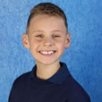
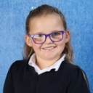
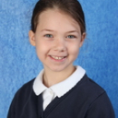
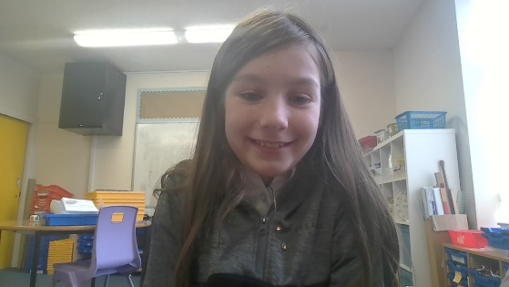
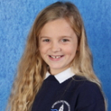
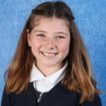
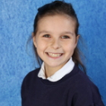
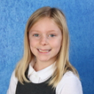
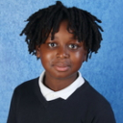
Friendship Ambassadors
Congratulations Jack, Millie, Ollie, Sofia, Viola, Lottie, Lila-Rose, Chloe, Elodie, Isla and Jesse – your applications for the role were fantastic and we think you will be fantastic role models! We know you will be amazing!

Slide 4
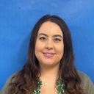
Here is Miss Camper
Miss Camper will be in the friendship zone to support the Friendship buddies to support you.

Slide 5
Here are our Buddy Benches…
Just come and sit here if you want some help, one of our buddies will be along to help as soon as they can!

Slide 6
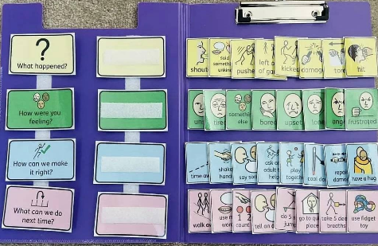
Here are our mentoring folders
The Friendship buddys will use these to help anyone who comes to the friendship zone.

Slide 7
Our Friendship ambassadors can help you if you are in the blue or the yellow zone.
They will ask an adult to help if they think someone is in the red zone.
An adult will always be close by to help the ambassadors and any child visiting the buddy benches.

Slide 8
What do our Friendship Ambassadors do?
Ensure that all children have someone to play with at lunchtime.
Give children someone to talk to and support with options of what they can do when they have had friendship issues on the playground.
Provide another safe area of the playground for all children.

Slide 9
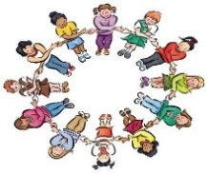
STRIVE
Our Friendship buddies will be looking out for children who are showing our STRIVE values. They can choose children to give house points to.
Friendship Buddy
House Point

Slide 10
Let’s pray
Dear God, Thank you for our new Friendship Ambassadors who will help to make sure our playground is a happy and safe place. Thank you, God, for the kindness and love that you show us. Please help us to forgive our friends for any fallings-out. Please help us to give people a second chance. Please help us to say sorry and start again. Amen

Slide 11
Call: May God grant to the world justice, hope and forgiveness
All: And make our school a
place of love and kindness

