Slide 3
Our vision as a Church of England school places Christian values at the heart of everything we do. The values are encapsulated in the acronym STRIVE - ‘Safety, Togetherness, Respect, Integrity, Valued and Excellence’. As a school community, we aim to serve one another and work together for the common good, so that everyone can experience life in all its fullness. (John 10:10). The parable of the mustard seed (Mark 4:30-32) can represent our children, who are nurtured here, and enabled to live life in its fullness through our teaching and care. It can also represent our school flourishing within our community and the community connecting to our diverse world.

Slide 4
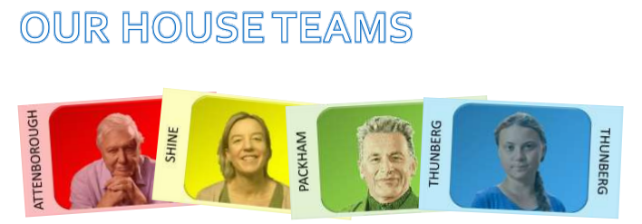
At Sutton Primary School, we have four house teams. These are based upon inspirational figures linked to nurturing and caring for our environment. When children join, they are allocated to a house team. For each house, we have a male and female house captain from Year 6. House Captains are responsible for promoting the ethos and values of their house, encouraging pupils to do their best in house competitions, and helping staff organise competitions. In line with our Behaviour Policy, throughout each day pupils can earn House Points for excellent effort in learning, excellent effort when completing home learning tasks, being an outstanding role model as well as many other opportunities. House Points accumulated each week are counted and in our weekly Celebration Assemblies the winning house for the week is announced. At the end of the academic year, the winning house is awarded the Rev. Mary Hancock House Cup.

Slide 5
Rewarding the Positive
We will be rewarding the children with praise focusing on positive behaviours.

Slide 6
Behaviour Policy
In order to reinforce behaviour expectations, Sutton Primary School use the following staged approach from our draft policy
Redirection – gentle encouragement to do the right thing.
Reminder – after giving the child time to process the redirection they will be reminded of what is expected.
Caution – calmly tell the child privately your expectations
Time in – in peaceful place in classroom or the reflection garden
Educational consequence – time spent during playtime to discuss the desired behaviour in class.
Internal referral – time in – 10 minutes in a partner class with work provided by the class teacher.
Reparation – for an educational consequence or internal referral. Chance to set positive goals for the future.
Notes:
Behaviour expectations
Uniform (shoes not trainers)
Exemplar work

Slide 7
Adults in my child’s class
Salamanders
Teacher - Mrs Ball
PPA - Mr Sellers (PE), Mrs Kent and Mrs Bradley (music)
Although TAs are based in these rooms, they do have a number of responsibilities across the school. This means they are not solely working alongside one class.
Notes:
Behaviour expectations
Uniform (shoes not trainers)
Exemplar work

Slide 8
Our School Day
Registration | 8:40-8:50
Break | 10:45-11
Lunch | 12:30 - 13:15
Home | 15:15
Pupils arriving after 8.55am are late and will be marked accordingly in the register. Please ensure your child comes to school on time. Pupils who are late should report to the school office. If you bring your child to school by car, we would ask you to note and respect the parking restrictions around the school site.

Slide 9
Fruit Snacks
Please encourage your child to bring piece of fruit for their morning snack if in KS2 Please note this is fruit only - not fruit winders or cereal bars). In KS1 fruit is provided by the government. Fruit is a great energy booster, and packed with vitamins to boost immunity, so makes a great mid morning snack!

Slide 10
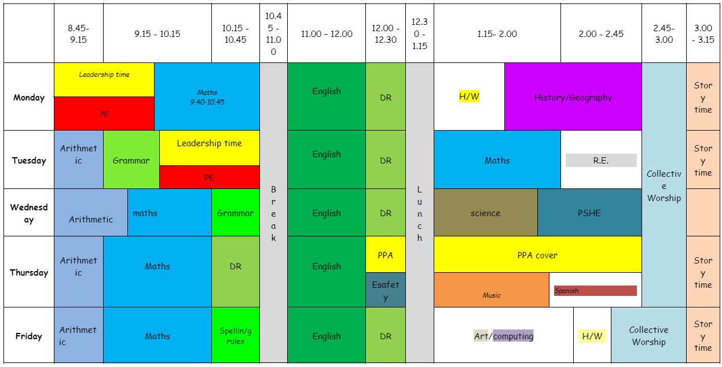
Our Class Timetable
Each class has a slightly different timetable - Science/ PE/ART/DT/PSHE/ /RE/Computing/Music will usually take place in the afternoons
Notes:
Handouts?
PE days

Slide 11
The important Bits…
PE DAYS
Monday and Tuesday
Spelling Test
Friday
School Trips
Tues 24th Sept - Duxford
Monday 11th Nov - Flag Fen
Summer term - Fitzwilliam Museum (date tbc)
Notes:
Handouts?
PE days

Slide 12
What are we learning?
Our Curriculum
Across the school, we follow the National curriculum and a cross curricular approach to learning. There is a clear focus on maths and English, but we strive to ensure that there is a broad, balanced and engaging curriculum across the school. Wherever possible clear links are made between subjects and each term classes have a different topic focus. Children develop their knowledge, skills and understanding and we provide a clear progression for these across the school.
At Sutton we have a carefully designed curriculum that promotes the curiosity of our pupils. We plan progressive learning with clear yearly objectives which build in small steps, recapping before moving on. More information can be found on our school website: https://www.sutton.cambs.sch.uk/web/curriculum_2/582663
Sutton School has now adopted a mastery approach to English and Mathematics. The mastery approach is a set of principles and beliefs on how children can best learn. We believe that all children are capable of understanding and doing the maths taught in their year group and that no child is ‘just bad at maths’. With good teaching, appropriate resources, effort and a positive ‘can do‘ attitude all children can achieve in and enjoy mathematics.
In practice, children will spend longer mastering each concept through small steps. Rather than pushing children onto larger numbers, or ‘harder maths’, those who grasp concepts quickly are encouraged to explore them in a variety of contexts and solve increasingly complex problems using them. This leads to a more thorough understanding of concepts taught and gives a firm foundation for the next year’s learning.

Slide 13
Times tables
By the end of year 2 children are expected to know their 2, 5 and 10 times table and be beginning to learn their 3’s.
Y3 - In Sutton we aim for the children to know all times tables up to 12x12
Y4 - children to work on speed

Slide 14
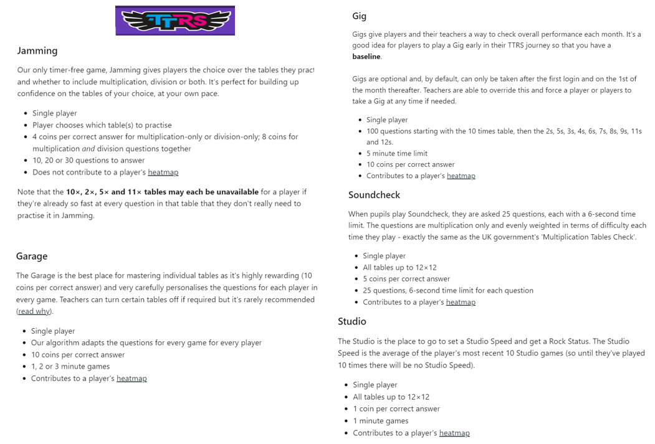

Slide 15
MTC
In June the Year 4 children will take part in the Multiplication Tables Check (MTC). This is a computerised tables test where children have 6 seconds to recall a times table and input the answer.
We will have lots of practice before then!

Slide 16
Year 4/5 - How it will work!
Autumn | Spring | Summer
Turning Points in History | Natural Disasters | Ancient Greeks vs Ancient Egyptians
Following life changing inventions through history. Stone age to iron age Invention of steam and railways Flight and WW2 Within this we will study OS maps and grid references. | Rivers - Sutton flooding Volcanoes (links to rocks in science) | Comparing the 2 civilisations

Slide 17
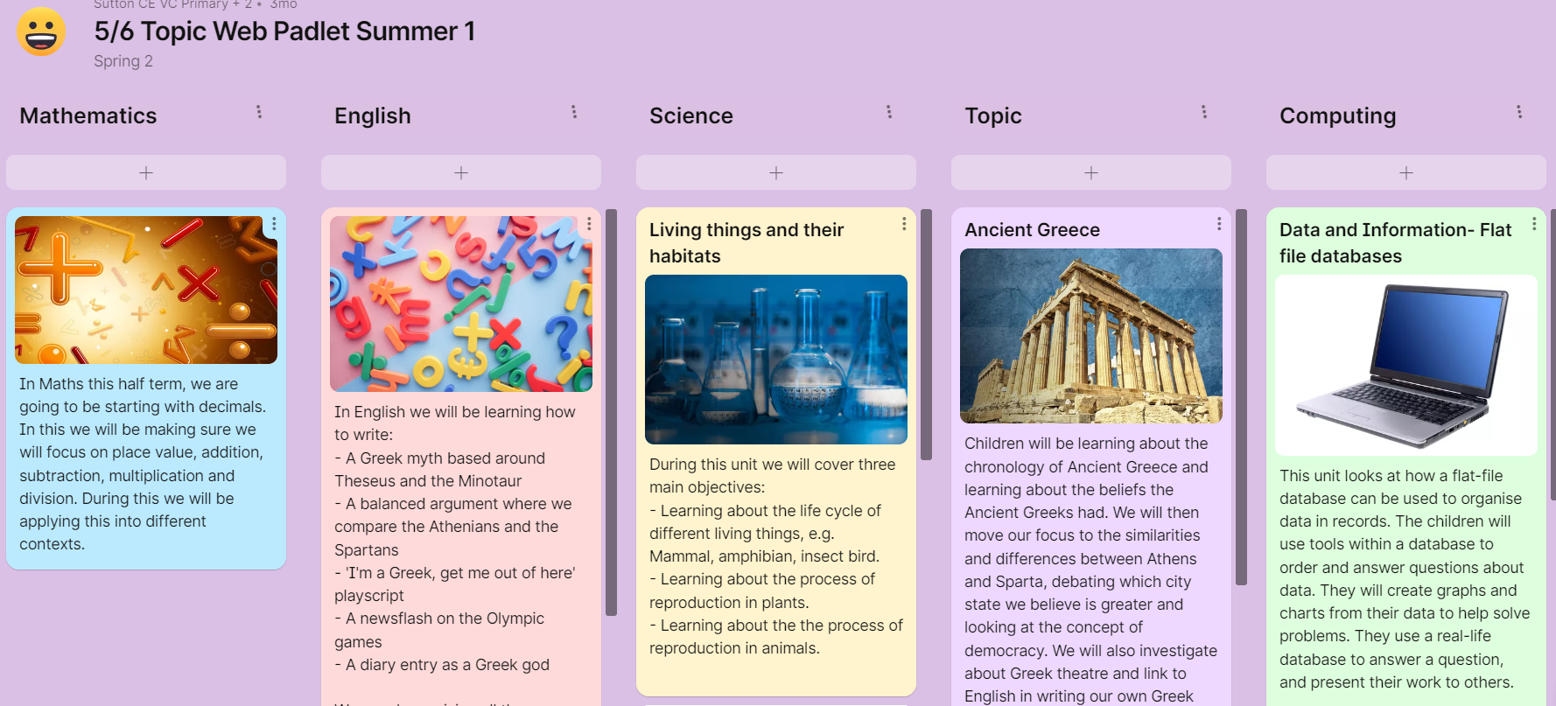
Padlets
These are shared with you termly, to give you an overview of what your child will be learning in each subject.

Slide 18
Destination Reader
When working on reading, we use Destination Reader. This comprises of an independent reading day, 3 days of whole class reading and a reading comprehension day. Throughout all of these sessions, the children will practice learning behaviours, the 7 strategies and reading to a partner and adult.
Reading a class text, linked to our topics, puts learning into context for the children, which they can transfer to other curriculum areas.

Slide 19
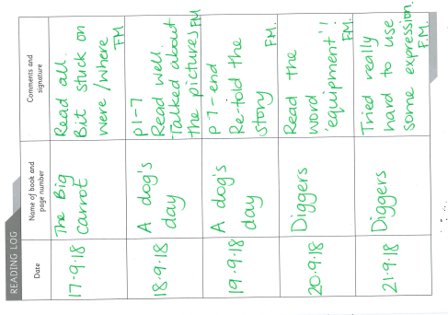
Reading Records
Children are to record each time they read
They can record their Destination Reading book in there
Please read at least 4 times a week (50 pages a week).
Every child should be have access to an independent book at their level and a free choice book, which can be brought to and from school.

Slide 20
Spelling
Each week your child will be given spellings to learn focused around a spelling pattern which will be tested during the week.
Spellings will be sent home on a Friday and tested the following Friday.

Slide 21
New spellings go out: Friday
Spelling test on: Friday
Log On:Stuck into reading record book.
Every child will also bring home a weekly spelling list to practice the rule being taught. These can also be accessed via Spelling Shed.

Slide 22
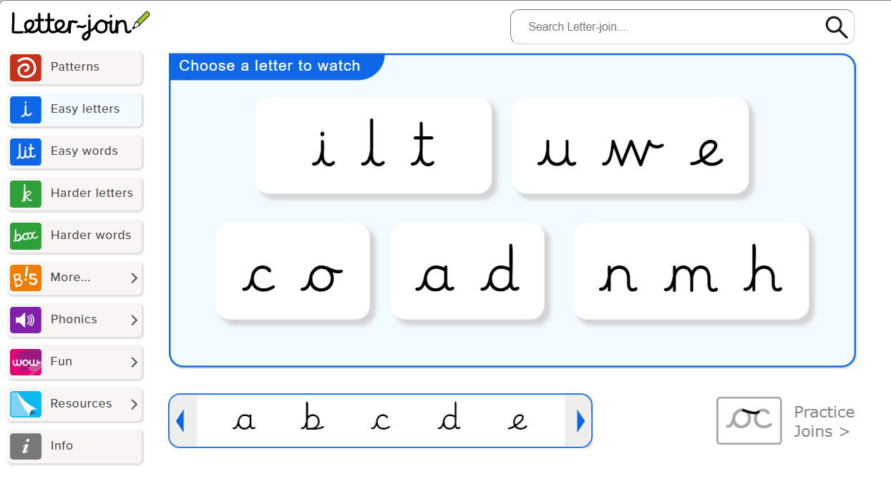
Handwriting
Each week, your child will be taught at least 2 sessions of handwriting. KS2 focus on a cursive approach with the aim of all handwriting being legible and joined (a requirement to achieve age-related expectations in Y6 SATs).
Pen licences will be given out when a child demonstrates legible cursive handwriting throughout all subjects or when a teacher deems suitable.

Slide 23
Assessment
Throughout the year there will be formative and summative assessment of the children across the curriculum. These judgements will be moderated internally, by Subject Leaders and within the cluster.
The evidence gathered will show that your child is working within one of the following:
Pre Key stage
Working towards age related expectations (WTS)
Working at age related expectations (ARE)
Working at greater depth (GDS)

Slide 24
Communication
School newsletters
Dojo
Pupil Asset
Website
Arrange a teacher meeting through the office (virtual or at a distance)
Notes:
Upcoming dates for trips
Assessments (SATS/Y4 timetable check)
How you can support children at home

Slide 25
Communication
Do let us know if you need any financial support, as it is possible you can be supported through pupil premium.
Were you aware that last year 20% of the children in Cambridgeshire who were eligible for a Free School Meal did not do so? Currently a school will receive £1,300 per pupil claiming Free School Meals. This money is called Pupil Premium Funding and can be used to support the child’s education in the form of smaller classes, TA support, if necessary or funding to help the pupil’s parents to meet the cost of school trips. This additional income is only received by the school if you apply for Free School Meals, however, please note that your child does not have to have a Free School Meal if they would prefer not to.
Don’t delay - Apply today! The office will be happy to support you - so do contact them, or let your class teacher know. There are also details on our website: https://www.sutton.cambs.sch.uk/web/pupil_premium_information/51473
Notes:
Upcoming dates for trips
Assessments (SATS/Y4 timetable check)
How you can support children at home

Slide 26
Birthdays
As a healthy school we observe the school policy of birthday book donations.
When it is your child's birthday, if you would like to, you can donate a book that your child's loves to the school. The book will be will be labelled with a special birthday sticker and placed in our lovely library for other children to then enjoy too.
Any students who bring in sweets for birthdays, will kindly be asked to take the sweets back home as we need to be mindful of healthy eating and dietary restrictions for various students.

Slide 27
The Year Ahead
Supporting your child at home
Notes:
Upcoming dates for trips
Assessments (SATS/Y4 timetable check)
How you can support children at home

Slide 28
Homework Expectations
Reading expectations in Guided reading. All children will be set a specific amount to read in Guided Reading. They are all aware that it is their responsibility to make sure this is done each week. If they don’t manage it in the sessions then they can take the book home.
Spellings. As explained before these are set on a Friday and then tested the following Friday.
Times tables. It is expected that by the end of Year 4 that children should know their times tables to 12 x 12. If your child does not then please make sure they are using TTRS as much as possible to help them secure them.

Slide 29
What can you do?
Read to your child, read with your child and have your child read to you.
Spellings – weekly spelling set on Spelling Shed.
Times tables - children have access to Times Table Rockstars.
Use the knowledge notes to recap key vocabulary and to help you discuss topics with your child.
Communicate with us! Let us know how it is going, and do let us know if you need any support :-)

Slide 30
Thank you!
We welcome any questions.

