Slide 1





Slide 2

Our vision as a Church of England school places Christian values at the heart of everything we do. The values are encapsulated in the acronym STRIVE - ‘Safety, Togetherness, Respect, Integrity, Valued and Excellence’. As a school community, we aim to serve one another and work together for the common good, so that everyone can experience life in all its fullness. (John 10:10). The parable of the mustard seed (Mark 4:30-32) can represent our children, who are nurtured here, and enabled to live life in its fullness through our teaching and care. It can also represent our school flourishing within our community and the community connecting to our diverse world.

Slide 3


Slide 4
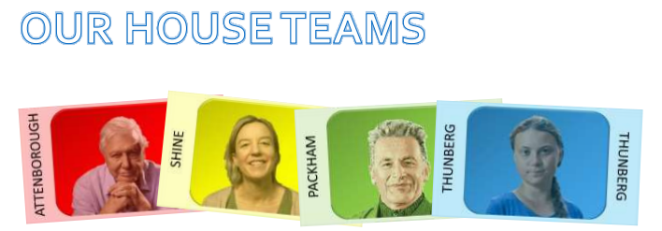
At Sutton Primary School, we have four house teams. These are based upon inspirational figures linked to nurturing and caring for our environment. When children join, they are allocated to a house team. For each house, we have a male and female house captain from Year 6. House Captains are responsible for promoting the ethos and values of their house, encouraging pupils to do their best in house competitions, and helping staff organise competitions. In line with our Behaviour Policy, throughout each day pupils can earn House Points for excellent effort in learning, excellent effort when completing home learning tasks, being an outstanding role model as well as many other opportunities. House Points accumulated each week are counted and in our weekly Celebration Assemblies the winning house for the week is announced. At the end of the academic year, the winning house is awarded the Rev. Mary Hancock House Cup.

Slide 5
Rewarding the Positive
We will be rewarding the children with praise focusing on positive behaviours.

Slide 6
Behaviour Policy
In order to reinforce behaviour expectations, Sutton Primary School use the following staged approach from our draft policy
  Redirection – gentle encouragement to do the right thing.
  Reminder – after giving the child time to process the redirection they will be reminded of what is expected.
  Caution – calmly tell the child privately your expectations
  Time in – in peaceful place in classroom or the reflection garden
  Educational consequence – time spent during playtime to discuss the desired behaviour in class.
  Internal referral – time in – 10 minutes in a partner class with work provided by the class teacher.
  Reparation – for an educational consequence or internal referral. Chance to set positive goals for the future.
Notes:
Behaviour expectations
Uniform (shoes not trainers)
Exemplar work

Slide 7
Our School Day
Registration |  | 8.45
Session 1 | Maths and Destination Reader | 9:00 - 10:45
Break |  | 10:45-11:00
Session 2 | English and SPaG or handwriting | 11:00-12:30
lunch |  | 12:30-13:15
Session 3 | 1 or 2 lessons | 13:15 - 14:45
Assembly |  | 14:45-15:00
Home Time |  | 15:15
Pupils arriving after 8.55am are late and will be marked accordingly in the register. Please ensure your child comes to school on time. Pupils who are late should report to the school office. If you bring your child to school by car, we would ask you to note and respect the parking restrictions around the school site.

Slide 8

Fruit Snacks
Please encourage your child to bring piece of fruit for their morning snack if in KS2 ( fruit only - not fruit winders or cereal bars). In KS1 fruit is provided by the government. Fruit is a great energy booster, and packed with vitamins to boost immunity, so makes a great mid morning snack!

Slide 9
Our Class Timetable
PE DAYS
Pangolins
Monday and Wednesday
Rhinos
Monday and Wednesday
Notes:
Handouts?
PE days

Slide 10
What are we learning?
Our Curriculum
Across the school, we follow the National curriculum and a cross curricular approach to learning. There is a clear focus on maths and English, but we strive to ensure that there is a broad, balanced and engaging curriculum across the school. Wherever possible clear links are made between subjects and each term classes have a different topic focus. Children develop their knowledge, skills and understanding and we provide a clear progression for these across the school.
At Sutton we have a carefully designed curriculum that promotes the curiosity of our pupils. We plan progressive learning with clear yearly objectives which build in small steps, recapping before moving on. We provide differentiated challenges - You may hear your child mentions - paddling, snorkelling and diving - As this relates to the level of challenge they have had a go at.
More information can be found on our school website: https://www.sutton.cambs.sch.uk/web/curriculum_2/582663

Slide 11
Sutton School has now adopted a mastery approach to mathematics. The mastery approach is a set of principles and beliefs on how children can best learn mathematics. We believe that all children are capable of understanding and doing the maths taught in their year group and that no child is ‘just bad at maths’. With good teaching, appropriate resources, effort and a positive ‘can do‘ attitude all children can achieve in and enjoy mathematics.
In practice, children will spend longer mastering each concept through small steps. Rather than pushing children on to larger numbers, or ‘harder maths’, those who grasp concepts quickly are encouraged to explore them in a variety of contexts and solve increasingly complex problems using them. This leads to a more thorough understanding of concepts taught and gives a firm foundation for the next year’s learning.

Slide 12
Topic Webs
These are shared with your termly, to give you an overview of what your child will be learning in each subject.
Autumn 1 | The Stone Age
Autumn 2 | The Bronze Age
Spring 1 | Water and Rivers
Spring 2
Summer 1 | Ancient Egypt
Summer 2

Slide 13
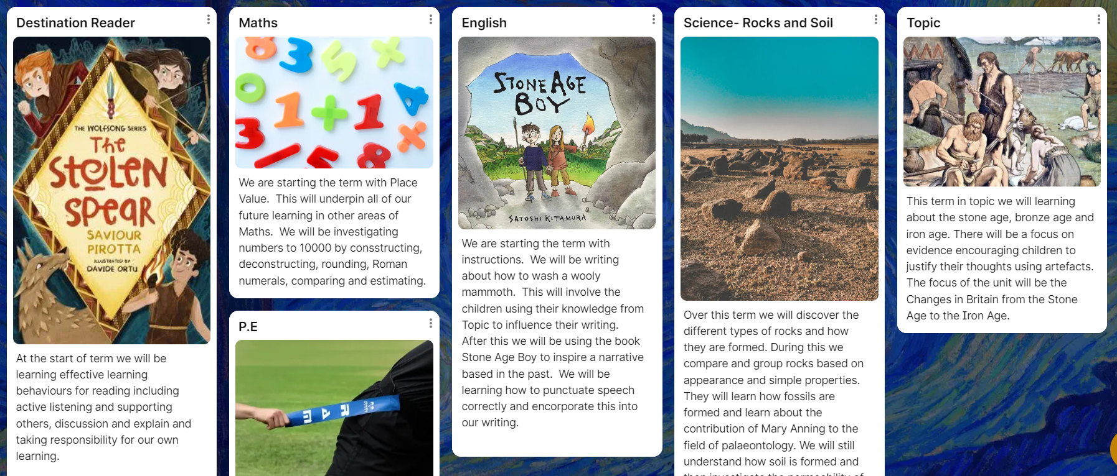
Padlets
Each term, these are on the website - so you can support your child with revisiting key concepts and vocabulary at home.

Slide 14
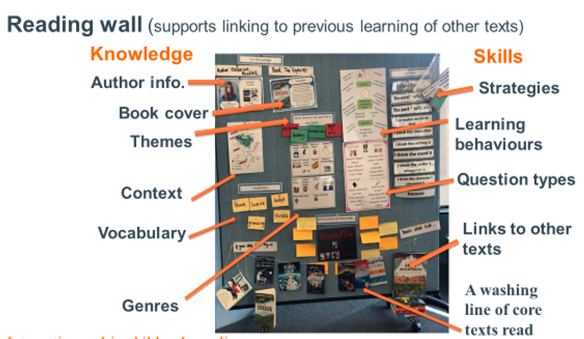
Destination Reader
When working on reading, we use Destination Reader. This comprises of an independent reading day, 3 days of whole class reading and a reading comprehension day. Throughout all of these sessions, the children will practice learning behaviours, the 7 strategies and reading to a partner and adult.
Reading a class text, linked to our topics, puts learning into context for the children, which they can transfer to other curriculum areas.

Slide 15
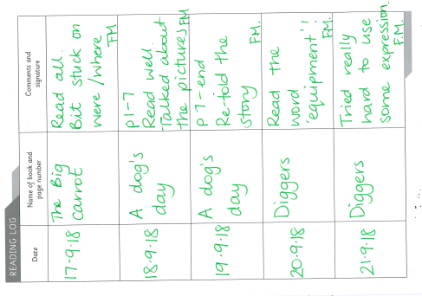
Reading Records
Write each time your child is heard read
Can just be initials
Useful to inform us about reading trends at home if possible
Please read 5 times a week.

Slide 16

New spellings go out: Fridays and tested the following Thursday
Log On: Stuck in back of reading record
Each week the spelling list will be sent to you on dojo to let you know our key spellings for the week.
We can print out activities if your child does not have access to a device, please let us know!

Slide 17
Spelling
Each week your child will be given spellings to learn focused around a spelling pattern which will be tested at the end of the week.
Spellings will ‘go live’ on SpellingShed each Friday, introduced in class on a Monday and tested the following Friday.

Slide 18
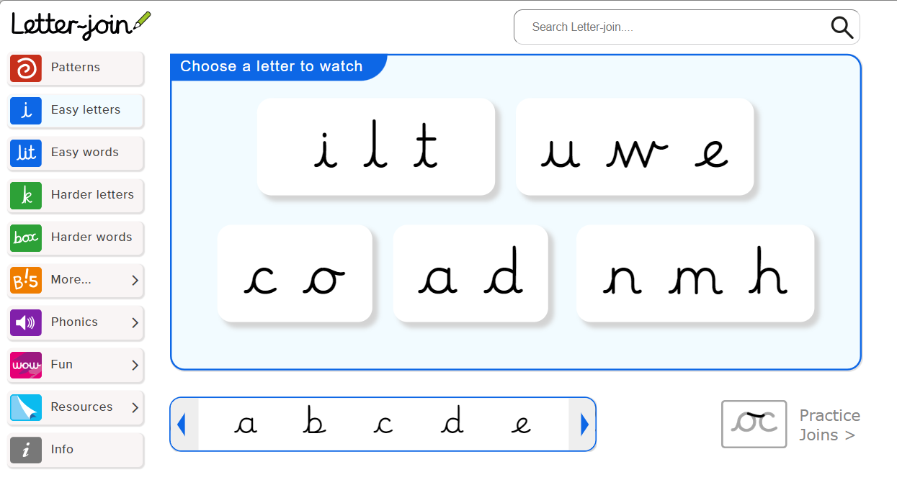
Handwriting
Each week, your child will be taught at least 2 sessions of handwriting. KS2 focus on a cursive approach with the aim of all handwriting being legible and joined (a requirement to achieve age-related expectations in Y6 SATs).
Pen licences will be given out when a child demonstrates legible cursive handwriting throughout all subjects or when a teacher deems suitable.

Slide 19
Times tables
  By the end of year 2 children are expected to know their 2, 5 and 10 times table and be beginning to learn their 3’s.
  Y3 - In Sutton we aim for the children to know all times tables up to 12x12
  Y4 - children to work on speed

Slide 20
MTC
In June the Year 4 children will take part in the Multiplication Tables Check (MTC). This is a computerised tables test where children have 6 seconds to recall a times table and input the answer.
We will have lots of practice before then!

Slide 21


Communication
School newsletters
Dojo
Pupil Asset
Website
Arrange a teacher meeting through the office (virtual or at a distance)
Notes:
Upcoming dates for trips
Assessments (SATS/Y4 timetable check)
How you can support children at home

Slide 22
Communication
Do let us know if you need any financial support, as it is possible you can be supported through pupil premium.
Were you aware that last year 20% of the children in Cambridgeshire who were eligible for a Free School Meal did not do so? Currently a school will receive £1,300 per pupil claiming Free School Meals. This money is called Pupil Premium Funding and can be used to support the child’s education in the form of smaller classes, TA support, if necessary or funding to help the pupil’s parents to meet the cost of school trips. This additional income is only received by the school if you apply for Free School Meals, however, please note that your child does not have to have a Free School Meal if they would prefer not to.
Don’t delay - Apply today! The office will be happy to support you - so do contact them, or let your class teacher know. There are also details on our website: https://www.sutton.cambs.sch.uk/web/pupil_premium_information/51473
Notes:
Upcoming dates for trips
Assessments (SATS/Y4 timetable check)
How you can support children at home

Slide 23

Birthdays
As a healthy school we observe the school policy of birthday book donations.
When it is your child's birthday, we politely request that you donate a book that your child's loves to the school. The book will be read aloud in class and will subsequently be labelled with a special birthday sticker and placed in our lovely library.
Alternatively, your child can bring in their favourite book for a read aloud and then take it home at the end of the day. Any students who bring in sweets for birthdays, will kindly be asked to take the sweets back home as we need to be mindful of healthy eating and dietary restrictions for various students.

Slide 24
The Year Ahead
Supporting your child at home
Notes:
Upcoming dates for trips
Assessments (SATS/Y4 timetable check)
How you can support children at home

Slide 25



What can you do?
Read to your child, read with your child and have your child read to you.
Spellings – weekly spellings set on Spelling Shed - please login to practice.
Times tables - please play TTRS as much as possible - 5 mins a day makes a huge difference. We will send other links to games throughout the year.
Use the knowledge notes to recap key vocabulary and to help you discuss topics with your child.
Communicate with us! Let us know how it is going, and do let us know if you need any support :-)

Slide 26
Thank you!
We welcome any questions.

