Slide 1
Teach reading: change lives
Parent workshop: Phonics and early reading in Reception, Phase 2
(Autumn 1)

Slide 2
Welcome to Elephant and Dolphins Reception phonics workshop!
Aims of today:
To understand how we teach children to read
For you to have a better understanding of how you can support your child at home
Notes:
Welcome
Introductions
Aim of today is for you to get a better understanding of how we teach children to read ….. We will go down to the classrooms in about 15 minutes where you will watch a phonics lesson
- We also want you to become really familiar with phonics ….. We hope that today will give you some ideas and tips to support your child at home

Slide 3
Phonics is:
making connections between the sounds of our spoken words and the letters that are used to write them down.
Notes:
So what is phonics?
Read the slide.
It sounds complicated but it really isn’t!
Phonics is the way we teach children to read and write. Research has shown that it is the BEST way to teach children to read and write. It helps children identify and use different sounds to distinguish one word from another…
So for example …..this is the letter ‘s’ S is the grapheme (show card) the sound/ the phoneme is a ‘ssssssss’
In teaching children to read, they hear the sound, they match it to the grapheme and so whether they are reading or writing, they can be successful
Through phonics teaching, children learn to blend the sounds of letters together and this helps them to decode unfamiliar words by sounding them out

Slide 4
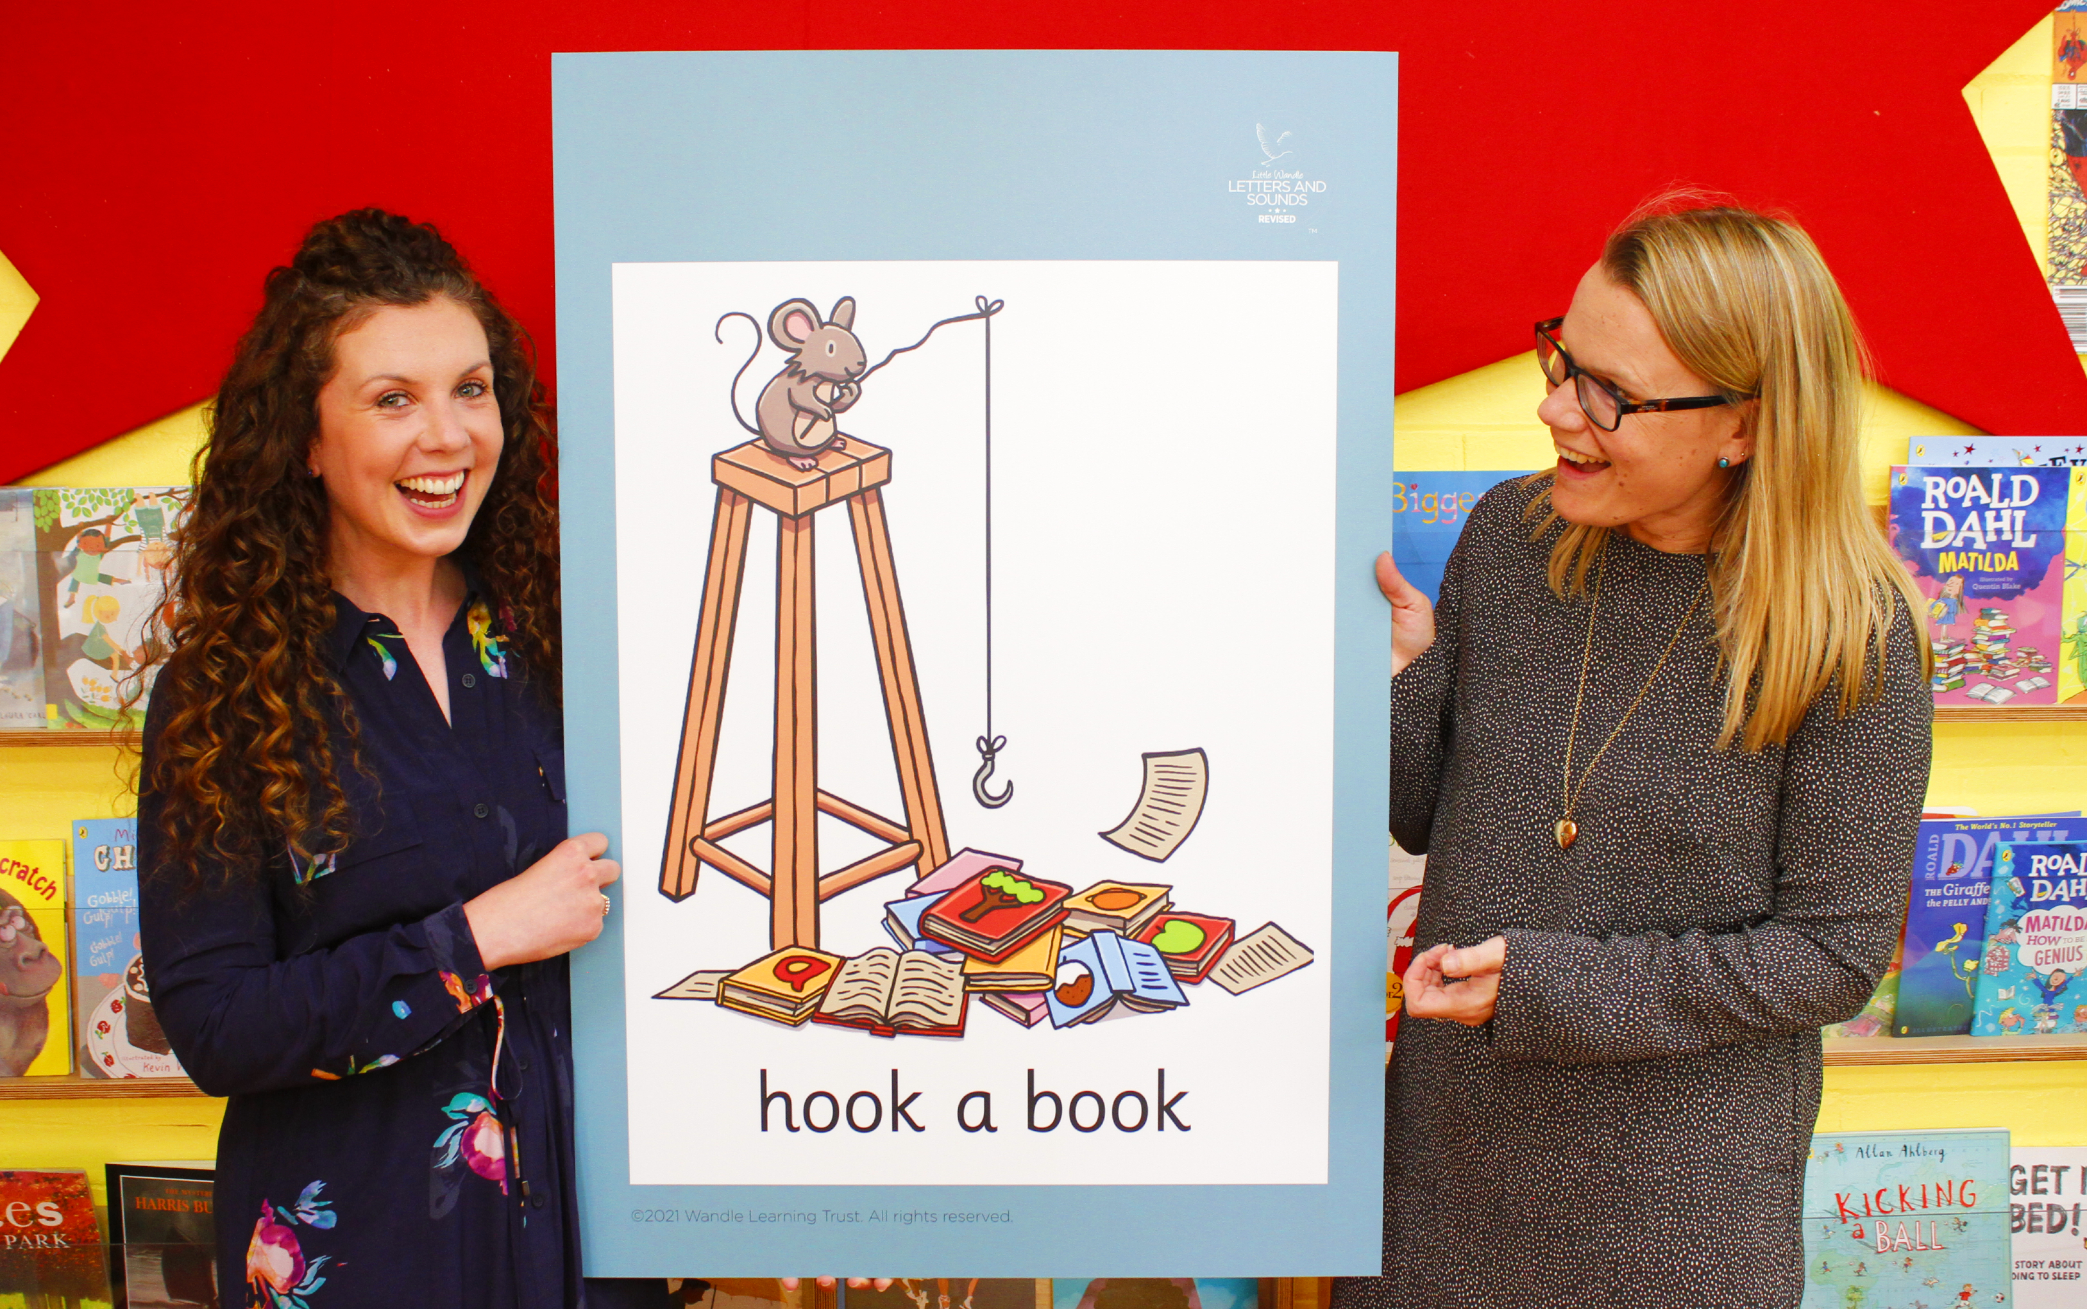
Little Wandle Letters and Sounds
Our school has chosen
Little Wandle Letters and Sounds as our Systematic Synthetic Phonics (SSP) programme to teach early reading and spelling.
Notes:
The scheme we use is ‘Little Wandle’
We have just about finished teaching your children all of the sounds they will learn in the Autumn term ….32 sounds, which includes some single letter sounds and some digraphs. We will continue to practice and apply these sounds for the remainder of the term, before moving on to the next set of sounds in January.

Slide 5
Terminology
Phoneme – the sound
Blend – joining the individual phonemes together to make a word
Grapheme – the sound written down
Digraph – 2 letters, 1 sound
Segment – identifying each sound in order to spell the word
Trigraph – 3 letters 1 sound
Notes:
We use these words with the children right from the start…. You will hear us in the lesson asking children to point out the digraph or trigraph when we read words (trigraphs will come in the Spring term)
Blending - Once the grapheme and phonemes involved have been learned, blending is the key process involved in reading words effectively. It is a skill that needs extensive practice. Practice in oral blending is very helpful (e.g. we play games – ‘What’s in the box’ ….in my box I have a c-a-t ….) both before and during the process of learning to read. Phonemes need to be joined into one continuous stream of sound to make a spoken word. Extensive practice and correct pronunciation is key (talked about on next slide)
Segment - To identify each of the individual phonemes in a word, working all the way through from left to right. This is an important first stage of writing (spelling) a word but needs to be practised orally first. Counting the phonemes is often helpful in reinforcing this process. EXAMPLE – when we want to spell a word e.g. sh – o – p (you will see a example of this in the lesson today)

Slide 6
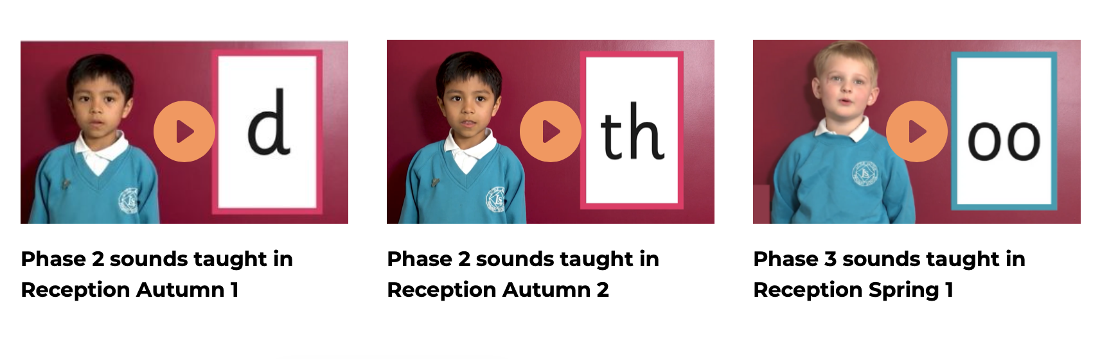
Supporting your child with phonics https://www.littlewandlelettersandsounds.org.uk/resources/for-parents/
Notes:
It is really important that you pronounce the sounds correctly at home when you are supporting your child. Children often start school knowing their alphabet, which is fantastic, but they are not always saying the sounds correctly. When we teach children to blend it is important that they sound the sounds correctly, e.g. ……. n – i –t (said with a ‘nuh’ is hard to blend nnnnnn – i-t ’ )
I would recommend watching these videos – link on pp to be uploaded to the website and please correct your children if they say nuh!
You also have a pronunciation guide with your handout. This is every sound we have taught this term and the order that they are taught in ~(apart from a couple of the digraphs … ll, zz, ss …but the pronunciation is the same)
This sheet also has the letter formation phrase on as well – when children are writing we encourage them to say these phrases as it helps with correct letter formation from the start, if they can picture it in the head, they can write it ….EXAMPLE – show card... They don’t need us to write and then they copy.

Slide 7
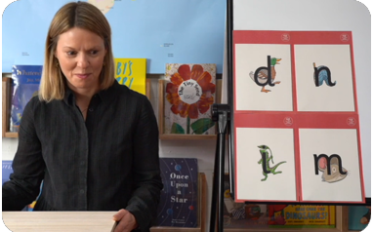
How we teach
The lessons are fun, interactive, engaging and have been designed to gradually build over time.
Recap previously learnt phonemes
Orally blend
Demonstrate how to physically blend
Practice reading ‘tricky words’*
Read a few words/ sentence* *
Write some words
Notes:
Every lesson follows the same format, so the children know exactly what to expect
*tricky words are words that the children can’t sound out because they have unusual spellings – e.g. he, was, the. We teach them by pointing out the tricky parts
**In the beginning we were reading just a couple of words, but now we are reading sentences of 6 words or more
All children are taught together, not in ability groups. However, during the lesson we notice and we assess. If a child needs additional support, they get it at another point during the day.
We have half termly assessments to check that children are able to recall and apply the sounds that they have learnt. If there are gaps, then they receive additional 1:1 of small group sessions to fill those gaps. We will let you know if your children are receiving additional support so that we can work together to support them.

Slide 8
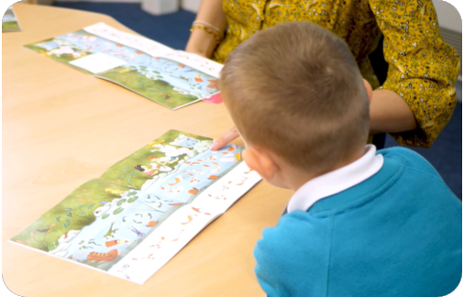
Reading a wordless books
Wordless books are invaluable as they teach reading behaviours and early reading skills to children who are not blending – yet!
Talk about the pictures.
Point to the images in the circles and find them on the page.
Encourage your child to make links from the book to their experiences.
Notes:
In addition to the phonics lesson, children have 3 reading practice sessions with a TA every week.
Reception children begin with wordless books …..READ SLIDE

Slide 9
How do we practise reading in books?
Reading practice sessions are:
timetabled three times a week
taught by a trained teacher/teaching assistant
taught in small groups
children in Reception will bring a book home by week 4 of the first half-term.
Notes:
When children are ready, they move onto books with words….
The children read the same book three times in a week.
The first time we work on decoding (sounding out) the words, the second time we work on prosody which is reading with expression – making the book sound more interesting with our story-teller voice or our David Attenborough voice – and the third time we look at comprehension.
We read the books three times at school because we want to develop the fluency.
The more children see words, the more they begin to read them automatically without having to sound them out.

Slide 10
Listening to your child read their phonics book
Your child should be able to read their book without your help.
They might sound out words and blend them before they read them fluently.
If they can’t read a word, read it to them.
Talk about the book and celebrate their success.
Notes:
LEAVE IN THE POWERPOINT FOR GOING ON WEBSITE

Slide 11

Questions?
Notes:
We often get asked
How can we support our child at home? (see next slide….)
-

Slide 12
How can I support my child at home?
Reading the phonics book we send home
Blending games e.g. ‘I spy’
Spelling shed (to support learning of ‘tricky words’)
Enjoying books together
Notes:
We often get asked
How can we support our child at home?
-

Slide 13

Books going home
Notes:
We want your child to be successful, so we will never send home a book that they cannot read.
At the beginning I said that phonics is the BEST way to teach your child to read….however, it is not the only way. Reading a book where you child has to sound out ...p-i-n …might give them a huge sense of achievement, but it is not going to give them a love of reading….that’s why we always send home a real book too…..so that you can enjoy it together.
Please read with your child as often as you can

Slide 14
One of the greatest gifts adults can give is to read to children
Carl Sagan
Notes:
Slide purpose:
Key takeaways/final message
Notes:
Read the quote.

