Slide 1




Notes:
Introduction - Louise

Slide 2

Notes:
Louise

Slide 3

Our vision as a Church of England school places Christian values at the heart of everything we do. The values are encapsulated in the acronym STRIVE - ‘Safety, Togetherness, Respect, Integrity, Valued and Excellence’. As a school community, we aim to serve one another and work together for the common good, so that everyone can experience life in all its fullness. (John 10:10). The parable of the mustard seed (Mark 4:30-32) can represent our children, who are nurtured here, and enabled to live life in its fullness through our teaching and care. It can also represent our school flourishing within our community and the community connecting to our diverse world.
Notes:
Louise - Link to strive

Slide 4
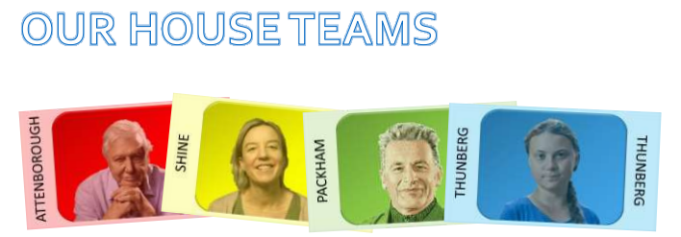
At Sutton Primary School, we have four house teams. These are based upon inspirational figures linked to nurturing and caring for our environment. When children join, they are allocated to a house team. For each house, we have a male and female house captain from Year 6. House Captains are responsible for promoting the ethos and values of their house, encouraging pupils to do their best in house competitions, and helping staff organise competitions. In line with our Behaviour Policy, throughout each day pupils can earn House Points for excellent effort in learning, excellent effort when completing home learning tasks, being an outstanding role model as well as many other opportunities. House Points accumulated each week are counted and in our weekly Celebration Assemblies the winning house for the week is announced. At the end of the academic year, the winning house is awarded the Rev. Mary Hancock House Cup.
Notes:
Louise

Slide 5
Rewarding the Positive
We will be rewarding the children with praise focusing on positive behaviours.
Notes:
Hannah

Slide 6
Behaviour Policy
In order to reinforce behaviour expectations, Sutton Primary School use the following staged approach from our draft policy
  Redirection – gentle encouragement to do the right thing.
  Reminder – after giving the child time to process the redirection they will be reminded of what is expected.
  Caution – calmly tell the child privately your expectations
  Time in – in peaceful place in classroom or the reflection garden
  Educational consequence – time spent during playtime to discuss the desired behaviour in class.
  Internal referral – time in – 10 minutes in a partner class with work provided by the class teacher.
  Reparation – for an educational consequence or internal referral. Chance to set positive goals for the future.
Notes:
Hannah - Behaviour expectations
Uniform (shoes not trainers)
Exemplar work

Slide 7
Our School Day
Registration
Phonics
SPAG and Spelling
English
Break
Maths
Reading Practice
Lunch
Story time
Foundation subjects
Collective Worship
Home time
8:40
9:00
9:20
9:40
10:30
10:45
11:40
12:00
12:45
1:00
2:50
3:10
Pupils arriving after 8.55am are late and will be marked accordingly in the register. Please ensure your child comes to school on time. Pupils who are late should report to the school office. If you bring your child to school by car, we would ask you to note and respect the parking restrictions around the school site.
Notes:
Nic

Slide 8
How are we learning?
Our Curriculum
Core Subjects
English
Maths
Reading Practice
Phonics
Science
Foundation Subjects
History
Geography
RE
Computing
PSHE
RE
PE
Notes:
Hannah

Slide 9
Maths Mastery
Sutton School has now adopted a mastery approach to mathematics. The mastery approach is a set of principles and beliefs on how children can best learn. We believe that all children are capable of understanding and doing the maths taught in their year group and that no child is ‘just bad at maths’. With good teaching, appropriate resources, effort and a positive ‘can do‘ attitude all children can achieve in and enjoy mathematics.
In practice, children will spend longer mastering each concept through small steps. Rather than pushing children onto larger numbers, or ‘harder maths’, those who grasp concepts quickly are encouraged to explore them in a variety of contexts and solve increasingly complex problems using them. This leads to a more thorough understanding of concepts taught and gives a firm foundation for the next year’s learning.

Slide 10
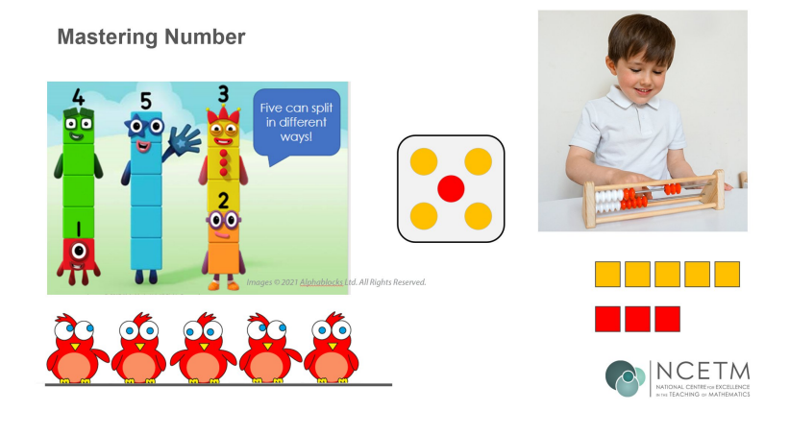
Fluency in Number

Slide 11

Notes:
Louise

Slide 12
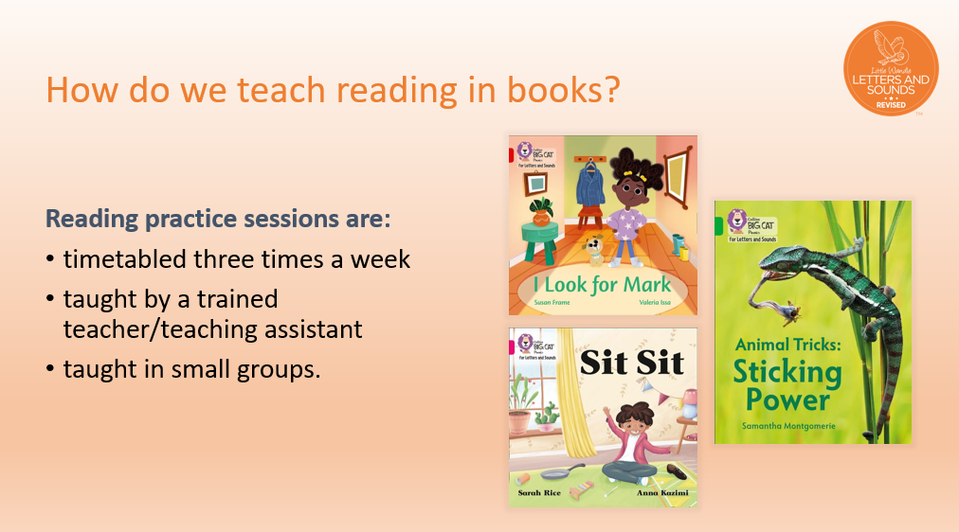
Notes:
Louise

Slide 13
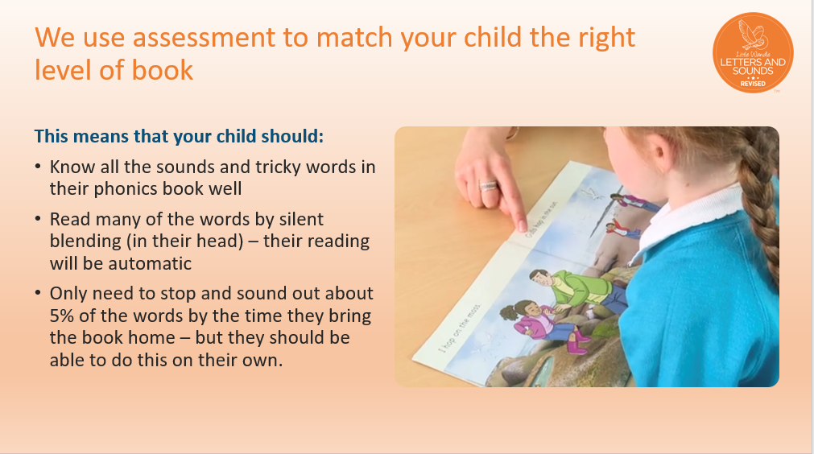
Notes:
Louise

Slide 14

Notes:
Louise

Slide 15
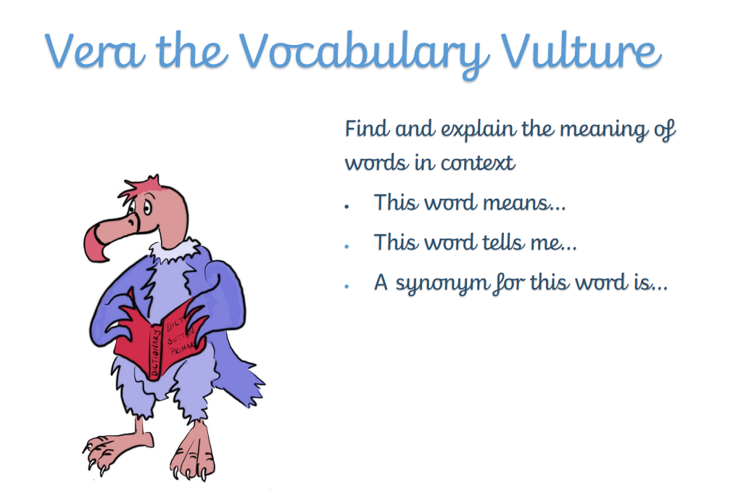
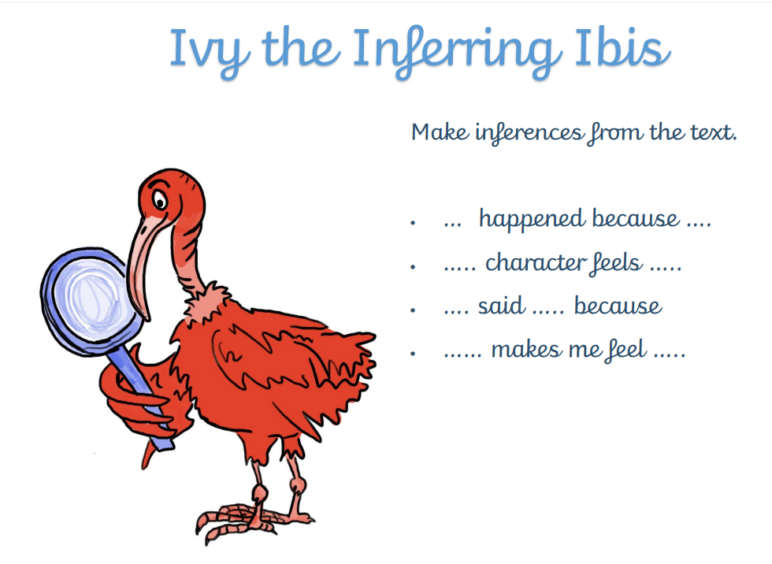
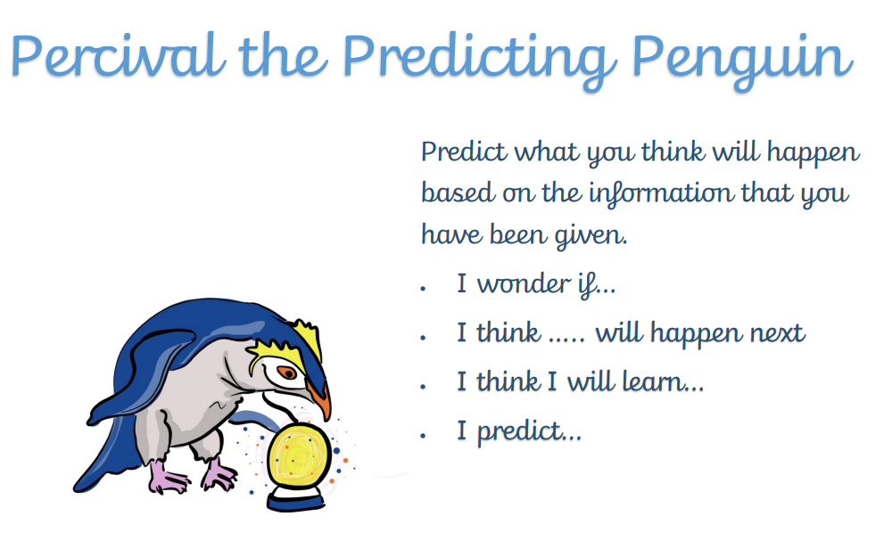
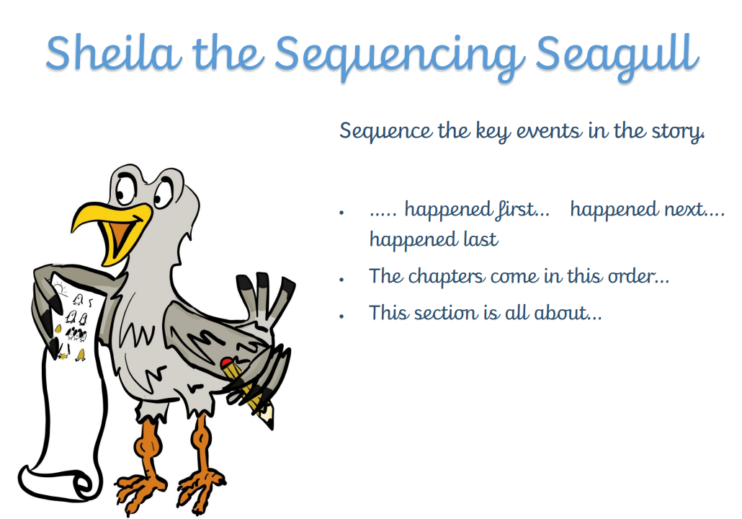
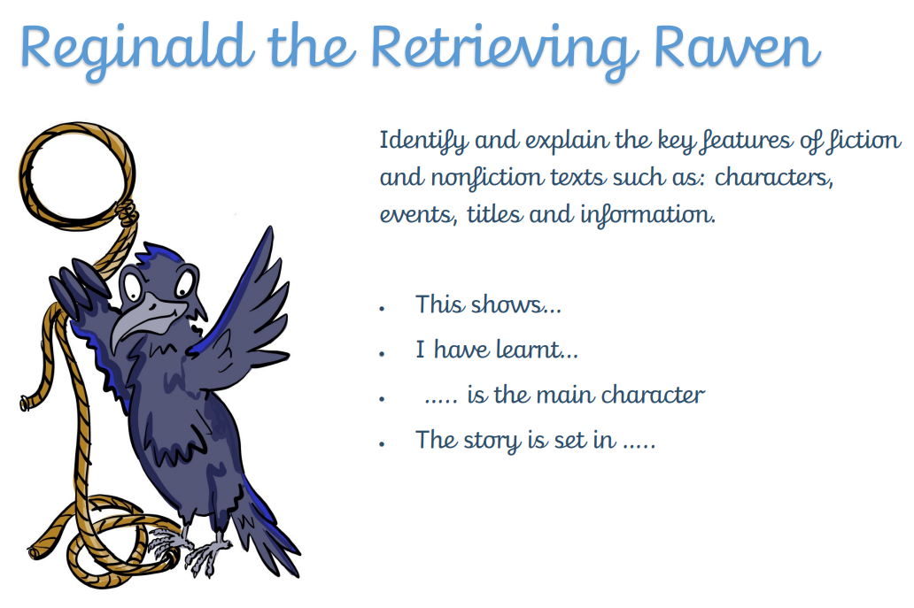
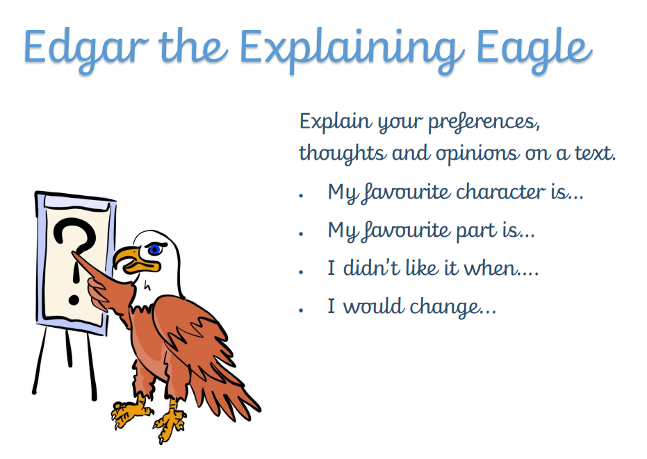
Vipers
We have attached the reading vipers skills which show the different types of questions that you can use to support your child with reading.
Your child’s teacher will be commenting on the skills they are working on in your child’s reading record, each week.
Notes:
Nic

Slide 16
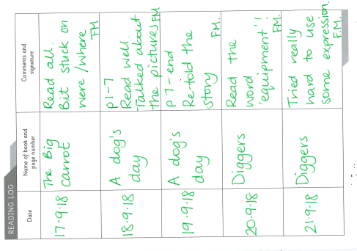
Reading Records
Write each time your child is heard read
Can just be initials
Useful to inform us about reading trends at home if possible
Please read 5 times a week.
Notes:
Louise

Slide 17
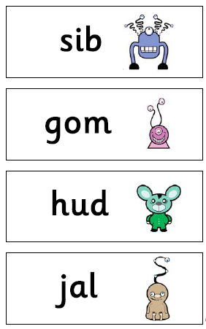
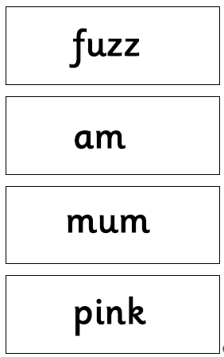
Year 1 and Year 2 phonics screening
We work on Phonics screening style words throughout the year so children will be used to sounding out and blending as part of their ordinary routine.
Notes:
Louise
There will be a phonics screening check in the Summer term. We will give you further information about this and how you can support your child nearer the time.

Slide 18

New spellings go out: Monday Spelling
Test on: Monday
Log On: Stuck in back of reading record
Each week the spelling list will be sent to you on dojo to let you know our key spellings for the week.
We can print out activities if your child does not have access to a device, please let us know!
Notes:
Louise

Slide 19
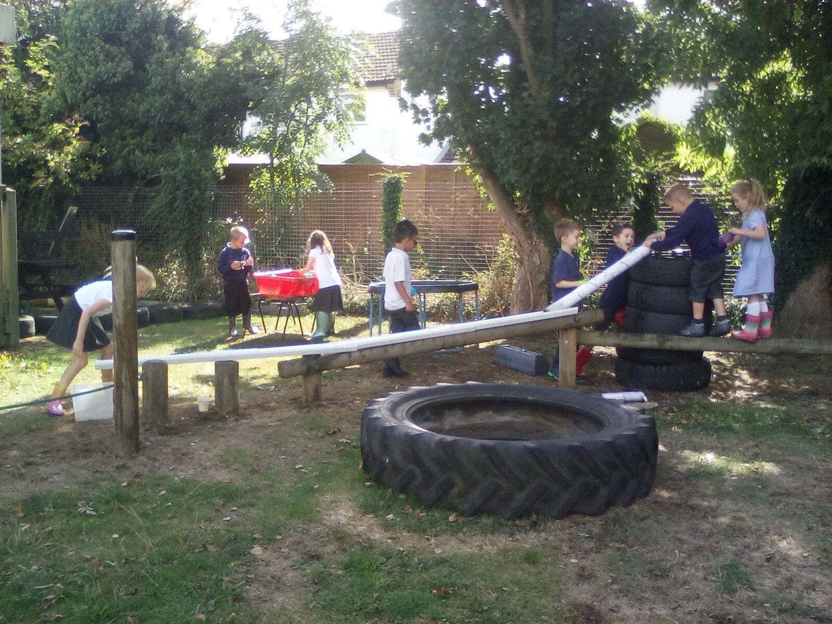
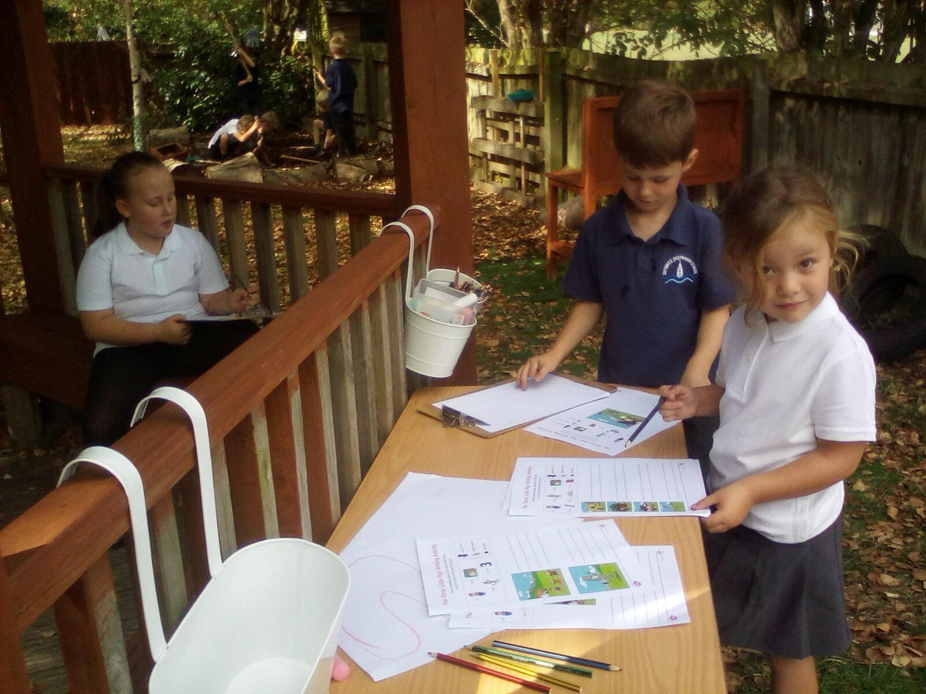
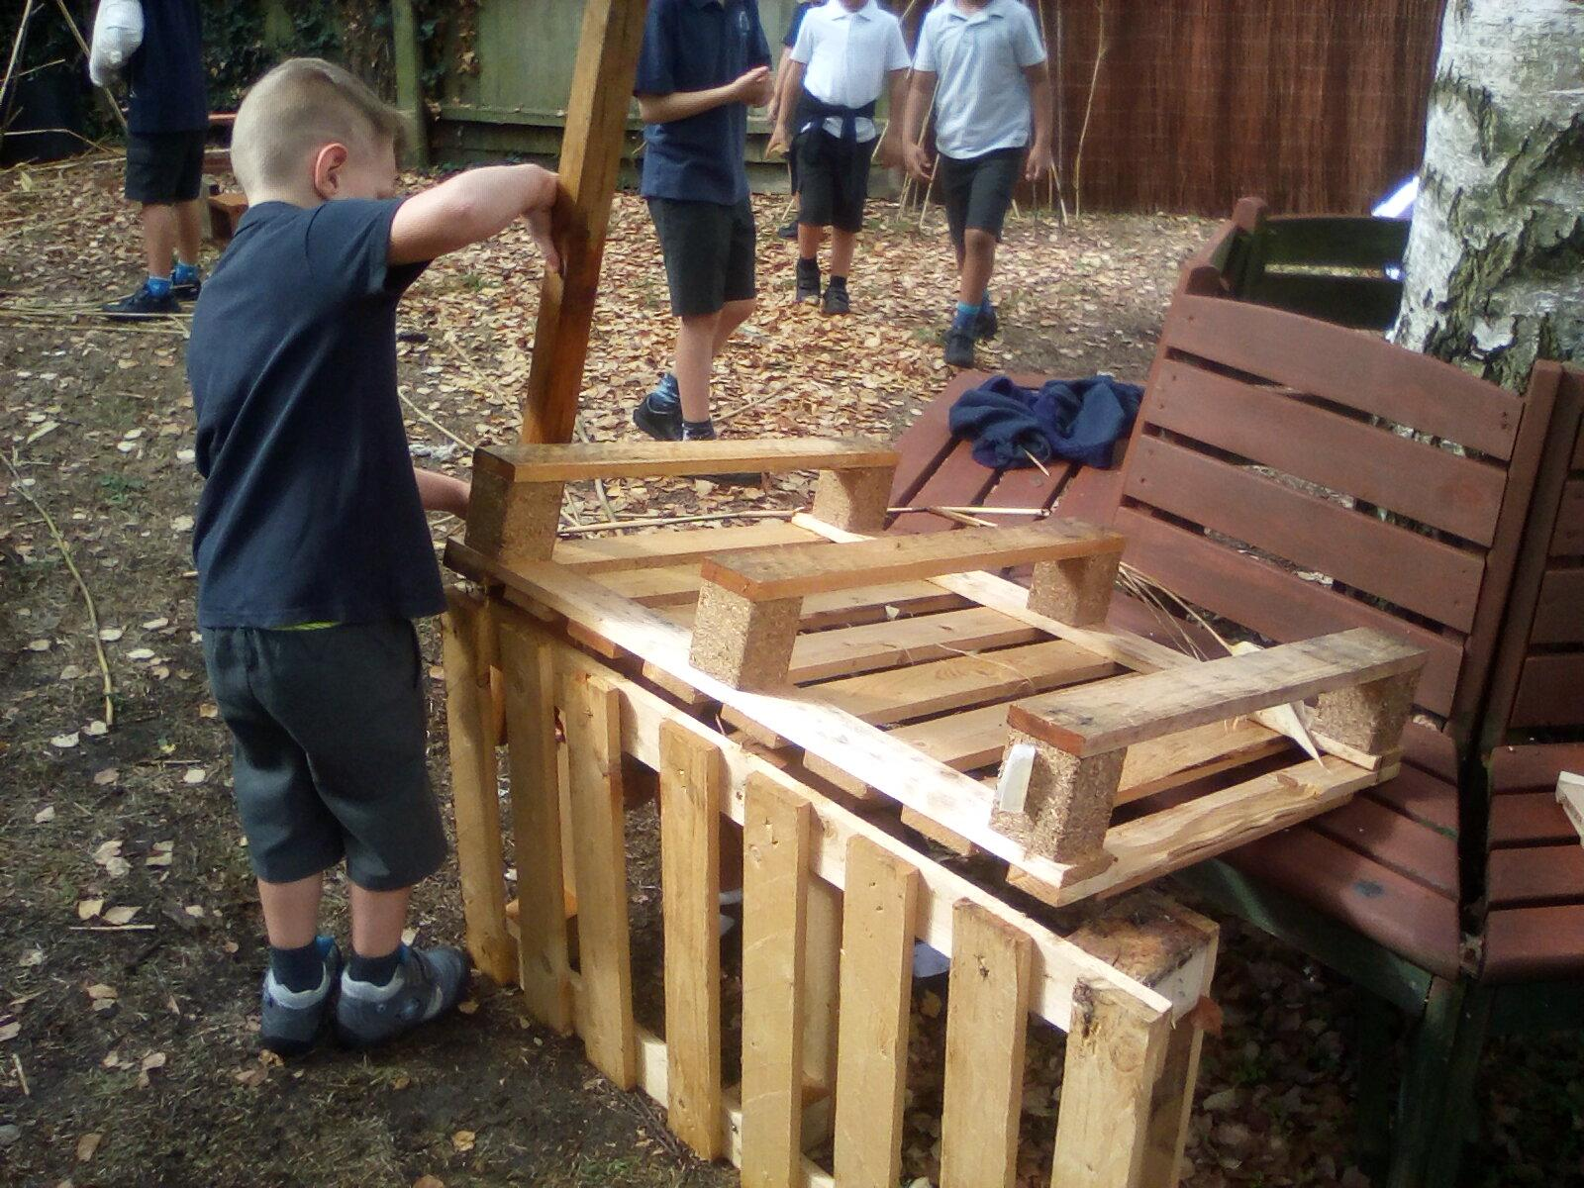
Outdoor learning
Independence
Cooperation
Problem solving
Skill consolidation
Care for the environment
Respect for nature
Developing vocabulary Communication skills
Skill building
Active learning
Notes:
Hannah

Slide 20
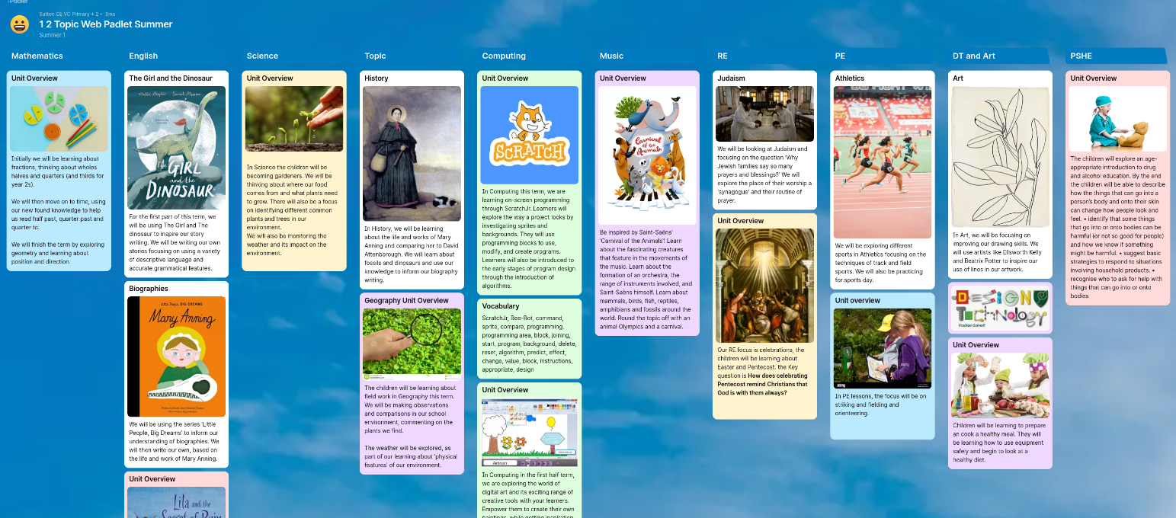
Topic Padlet
Notes:
Nic - Trip to Ramsey Rural Life Museum - when/ where/ what

Slide 21
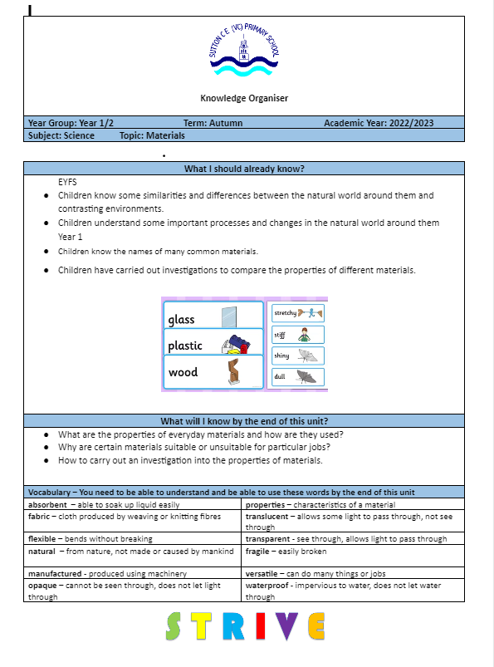
Knowledge notes
Each term, these along with the topic webs are on the website - so you can support your child with revisiting key concepts and vocabulary at home.
Notes:
Nic

Slide 22

Our Class Timetable
PE DAYS
Iguana:
Tuesday
Wednesday
Gorilla:
Monday
Tuesday
Notes:
Nic
Handouts?
PE days

Slide 23

End of Year Expectations
Notes:
Nic

Slide 24
Teacher Assessment
Pre Key stage
→ Working towards
→ Working at expected standard
→ Working at greater depth
Notes:
Nic
We will upload the statements to the website for you to see/ a link to the government website

Slide 25
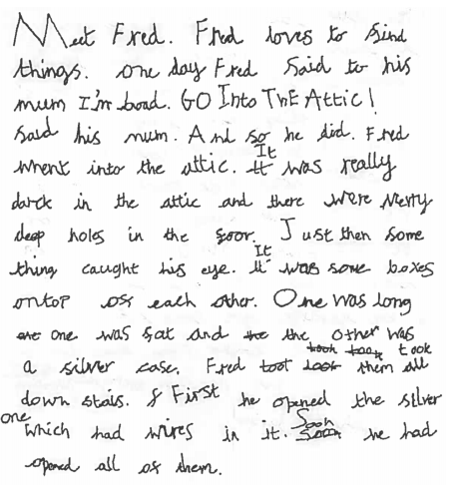
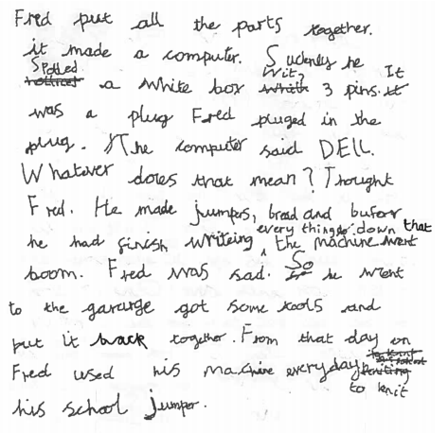
This is an example of a child working at the expected standard for writing at the end of year 2.
Notes:
We will upload the statements to the website for you to see/ a link to the government website

Slide 26
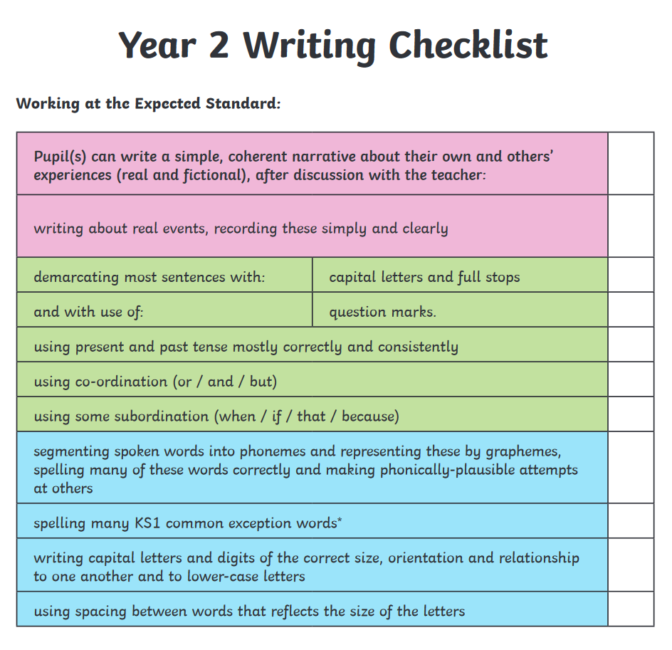
These are the writing targets we work on throughout year 2.
Notes:
We will upload the statements to the website for you to see/ a link to the government website

Slide 27
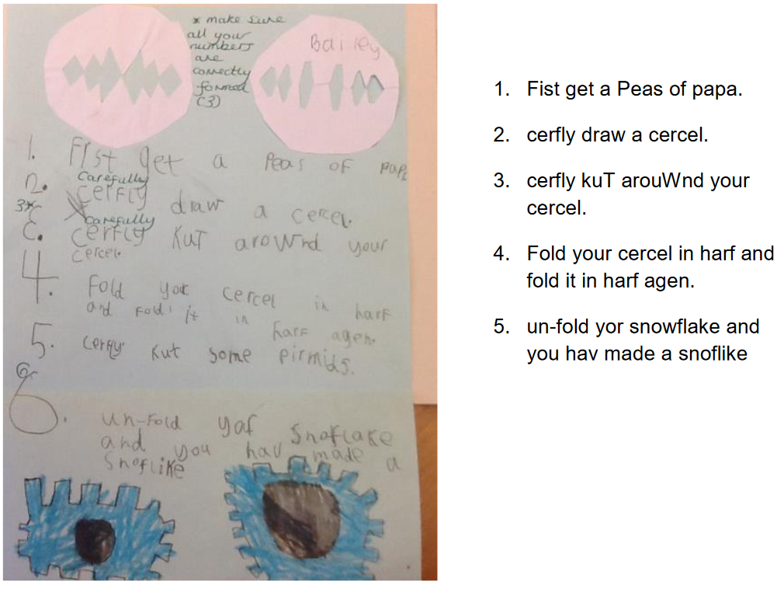
This is an example of a child working at the expected standard for writing at the end of year 1.
Notes:
We will upload the statements to the website for you to see/ a link to the government website

Slide 28
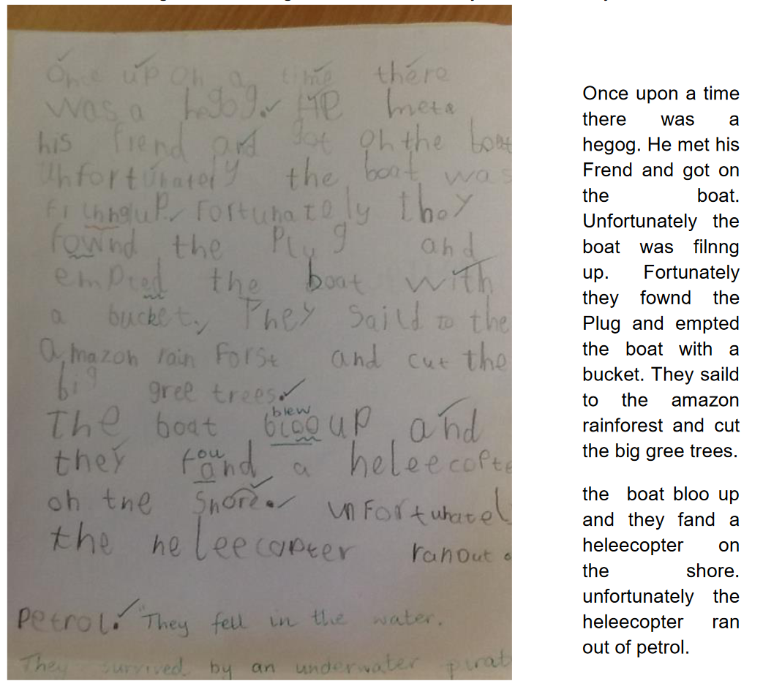
This is an example of a child working at the expected standard for writing at the end of year 1.
Notes:
We will upload the statements to the website for you to see/ a link to the government website

Slide 29
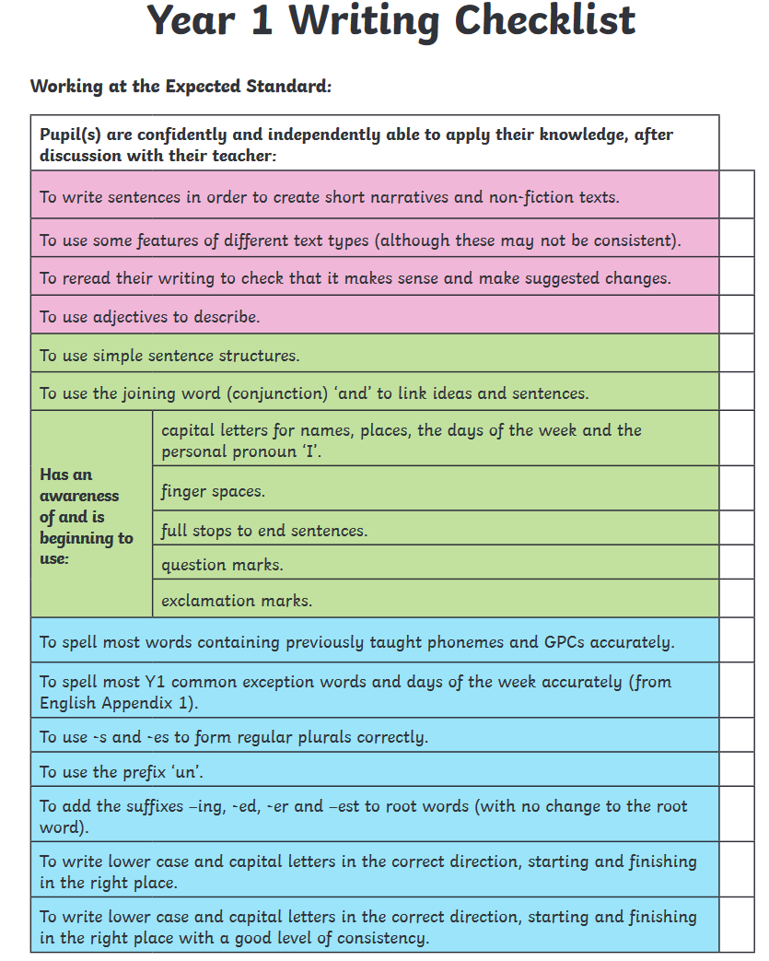
These are the writing targets we work on throughout year 1.
Notes:
We will upload the statements to the website for you to see/ a link to the government website

Slide 30
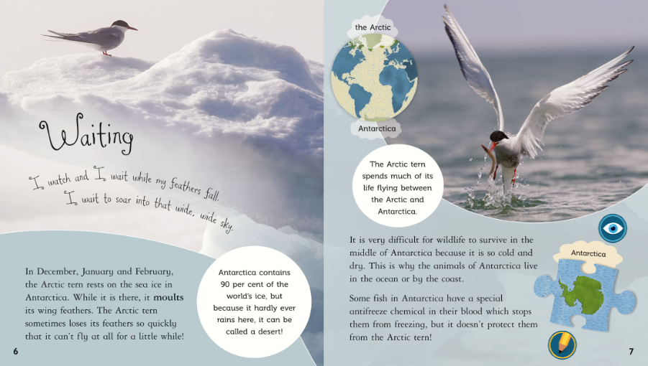
This is the expected level of text for children to read fluently by the end of year 2 e.g. approximately 90 words correct per minute.

Slide 31
Times tables
Please practice counting with your child at home.
  Y1 doubling and halving
  counting in 2s, 5s and 10s
  Y2 2s, 5s and 10s
Numbots
Notes:
Louise

Slide 32


Communication
Do let us know if you need any financial support, as it is possible you can be supported through pupil premium.
Were you aware that last year 20% of the children in Cambridgeshire who were eligible for a Free School Meal did not do so? Currently a school will receive £1,300 per pupil claiming Free School Meals. This money is called Pupil Premium Funding and can be used to support the child’s education in the form of smaller classes, TA support, if necessary or funding to help the pupil’s parents to meet the cost of school trips. This additional income is only received by the school if you apply for Free School Meals, however, please note that your child does not have to have a Free School Meal if they would prefer not to.
Don’t delay - Apply today! The office will be happy to support you - so do contact them, or let your class teacher know. There are also details on our website: https://www.sutton.cambs.sch.uk/web/pupil_premium_information/51473
Notes:
Louise

Slide 33
Communication
School newsletters
Dojo
Pupil Asset
Website
Arrange a teacher meeting through the office
Notes:
Louise

Slide 34

Birthdays
As a healthy school we observe the school policy of birthday book donations.
When it is your child's birthday, we politely request that you donate a book that your child's loves to the school. The book will be read aloud in class and will subsequently be labelled with a special birthday sticker and placed in our lovely library.
Alternatively, your child can bring in their favourite book for a read aloud and then take it home at the end of the day. Any students who bring in sweets for birthdays, will kindly be asked to take the sweets back home as we need to be mindful of healthy eating and dietary restrictions for various students.
Notes:
Nic

Slide 35
The Year Ahead
Supporting your child at home
Notes:
Upcoming dates for trips
Assessments (SATS/Y4 timetable check)
How you can support children at home

Slide 36



What can you do?
Read to your child, read with your child and have your child read to you.
Spellings – weekly spelling.
Times tables and number bonds.
Use the knowledge notes to recap key vocabulary and to help you discuss topics with your child.
Communicate with us! Let us know how it is going, and do let us know if you need any support :-)
Notes:
Hannah

Slide 37
Thank you!
We welcome any questions.

